Slide 1
PMP Advisory Committee
November 6, 2020

Slide 2
Housekeeping: Functions

Slide 3
Housekeeping: Communication
ALL QUESTIONS

Slide 4
Housekeeping
Mute phones
Do not place call on hold
Identify yourself

Slide 5
PMPAC Members
Julie Adkins, APRN
*Helga Brake, Pharm D
Cara Brock, Pharm D
William Campbell, DO
Kenneth Candido, MD
Ankur Dave, MD
*Raechel Ferry-Rooney, APRN
*Scott Glaser, MD
Shami Goyal, MD
Christopher Herndon, Pharm D
David Liebovitz, MD
*Garry Moreland, RPh
*Christina Morettin, OD
**Edward Rentschler, DDS
Mindy Sanders, PA

Slide 6
WELCOME
Approval of Meeting Minutes

Slide 7
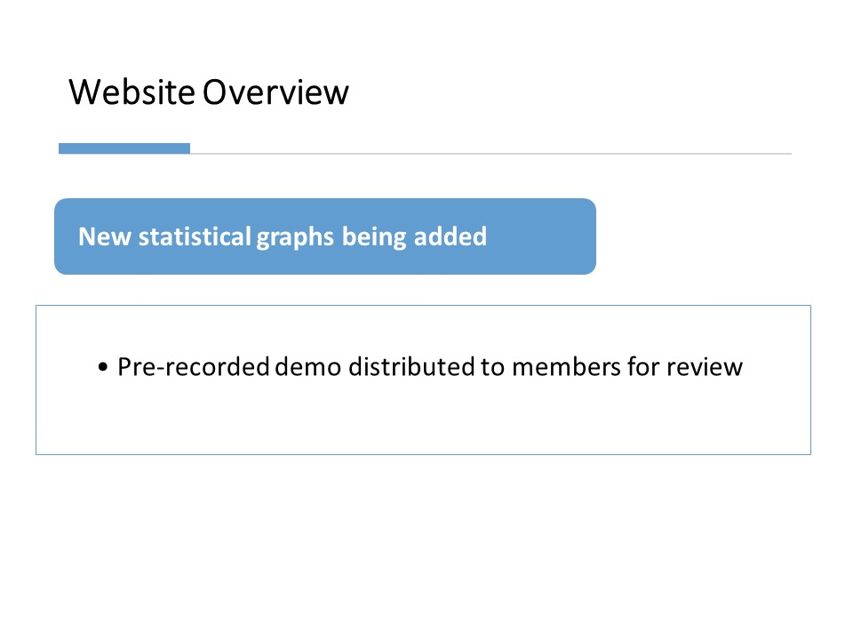
Website Overview
New statistical graphs being added
Pre-recorded demo distributed to members for review

Slide 8
Type of graphs used to display State-wide statistics:
Illinois State map with county based control substance prescriptions
Line graph comparing opioid, benzodiazepine and stimulants
Gender based comparison of number of opioid patients
Pie chart with all controlled substance drug comparison

Slide 9
Call to action
Request Feedback
Additonal data for display
Suggested visualizations
Ways to provide more meaningful data
Improving functionality

Slide 10
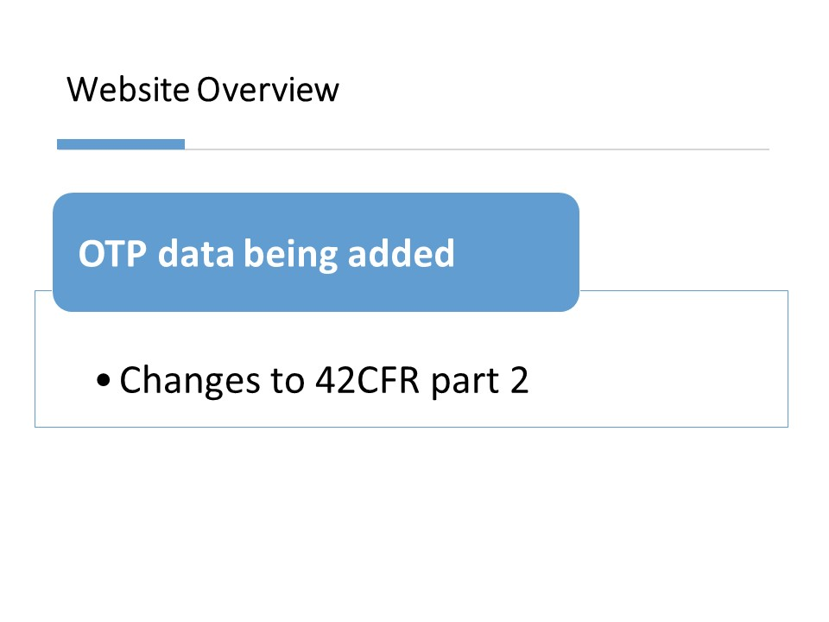
Website Overview
OTP data being added
Changes to 42CFR part 2

Slide 11
SAMHSA revisions to Part 2 Regulations for the Confidentiality of SUD Patient Records
Confidentiality of Substance Use Disorder Patient Records regulations located at 42 C.F.R. Part 2

Slide 12
Revisions Related to PDMPs
Disclosure to Central Registries and PDMPs: The final rule amends the disclosure requirements to
(A) allow non-opioid treatment providers to access central registries, in order to determine whether a patient is already receiving opioid treatment; and
(B) allow opioid treatment providers to disclose dispensing and prescribing data, as required by applicable state laws, to prescription drug monitoring programs (PDMPs), subject to patient consent.

Slide 13
HB3889
Amends the Illinois Controlled Substances Act. Provides that the requirements for transmitting information to the central repository under the Prescription Monitoring Program also apply to opioid treatment programs that prescribe Schedule II,III, IV, or V controlled substances for the treatment of opioid use disorder

Slide 14
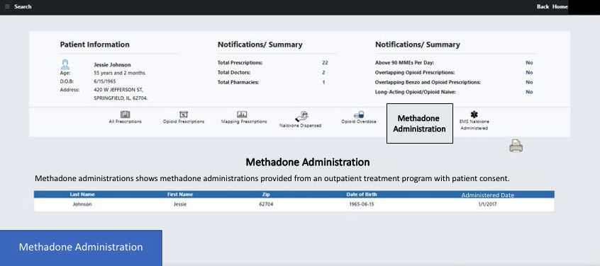
OTP Methadone Administrations

Slide 15
Website Overview
MyPMP
Proactive Notification Plan
Clinical Decision Tools

Slide 16
Proactive Notification System
Event triggered notifications
Notifications sent to a specific role or location.
Sent to prescribers via email, website pop up and/or text messages.
Triggered when patient meeting a threshold such as overdose
Role/ Location Based Notifications
Event types:
If a threshold is met
Created by PMP admin

Slide 17
Notification Fatigue
To address notification fatigue, PMP is planning the following:
User permissions to enable notifications based on time and frequency
Time triggered notifications e.g. by weekly, once a month
Acknowledgement (once a user views and acknowledges, the notification goes away)
Limited number
Send our notification only when the event is triggered (threshold met)

Slide 18
Clinical Tools for Guideline Implementation
Based on CDC Guidelines for Prescribing opioids in Chronic Pain
Triggers recommendation when patient thresholds are met
Initiating therapy with LA Opioids
High Dose Opioids
Overlapping Opioid and BZD
Mitigate Risks (naloxone co-prescribing)

Slide 19
If appropriate, consider implementing the following recommendations from
the CDC Guidelines for Prescribing Opioids for Chronic Pain
Recommendation #4 -When starting opioid therapy for chronic pain, clinicians should prescribe immediate-release opioids instead of extended-release/long-acting (ER/LA) opioids.
Recommendation #5 - When opioids are started, providers should prescribe the lowest effective dosage.
Recommendation #8 - Before starting and periodically during continuation of opioid therapy, clinicians should evaluate risk factors for opioid-related harms.
Recommendation # 11- Clinicians should avoid prescribing opioid pain medication and benzodiazepines concurrently whenever possible.

Slide 20
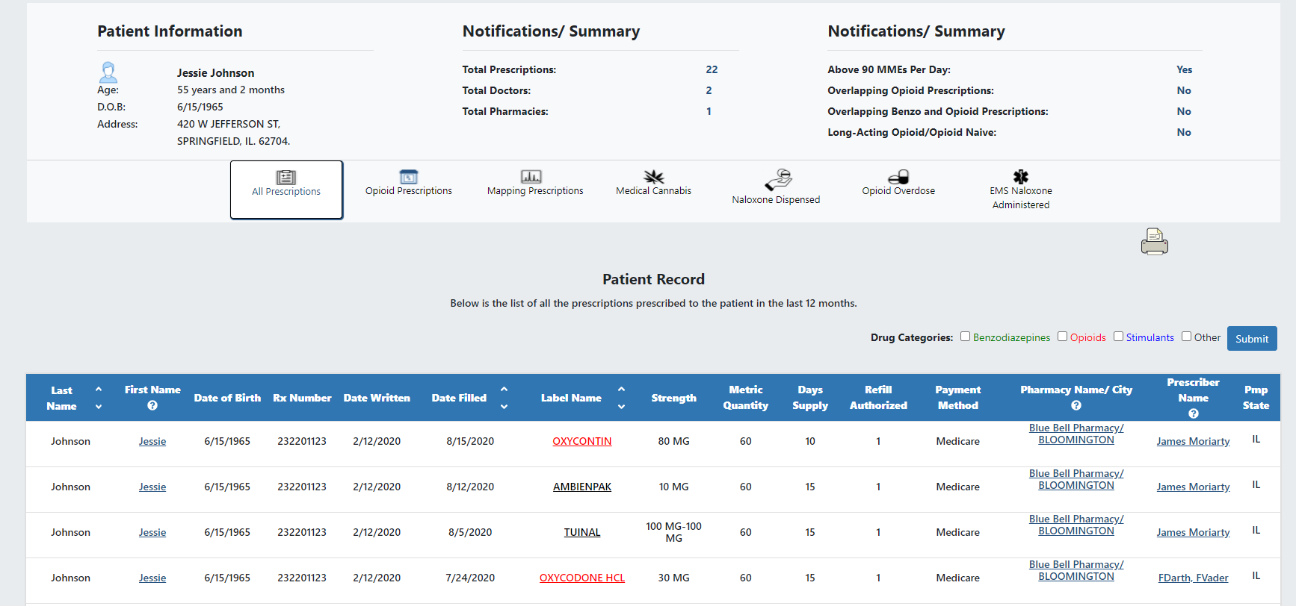
All Prescriptions
Recommendations

Slide 21
Public Act 100-0564
By 2021, the PMP shall interface with Electronic Health Record systems and shall include integration of pharmacy records with the PMP to enhance transfer of information

Slide 22
The PMP automated connection
10,972
Individual connection points including hospitals pharmacies, physician practices, local health departments, dental, optical, long term care facilities, and treatment centers.

Slide 23
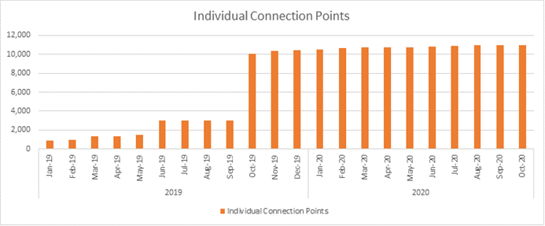

Slide 24
Additional PMP Projects highlighted
Helpline referral system
IANS

Slide 26
Injury and Accident Notification System
The Illinois PMP proposes implementation of an available solution to detect related healthcare transactions like injury and accidents (including opioid overdoses).
PROPOSAL
The connected healthcare organizations, through their existing EHR’s, will have the ability to send HL7 messages to transmit overdose, injury, accident and other relevant information to the PMP.
BACKGROUND
RATIONALE/KEY SUCCESS FACTORS
Leverages the currently existing ~11,000 connections and 100,000+ users to improve sharing of patient accident and overdose information.
The collected healthcare information can also be used for alerting and trending analysis.
UPSIDE POTENTIAL
Developing multiple data sharing platforms to receive overdose data and other relevant healthcare information increases the time and cost to achieve goal.
RISK OR ALTERNATIVES

Slide 27
Newsletters
Newsletters are a great way to create awareness. PMP is planning to redesign newsletters to include:
PMP website updates
FAQs about PMP, if any. (at max 2 questions per newsletter)
Response to COVID-19
Data graph

Slide 28
Lessons Learned in COVID regarding opioids
Open Discussion

Slide 29
Peer Review
New Data format LIVE!!!
Pre-recorded demo to be sent
Validation of Cumulative Score
SIU-e
Meeting Scheduled November 24th

Slide 30
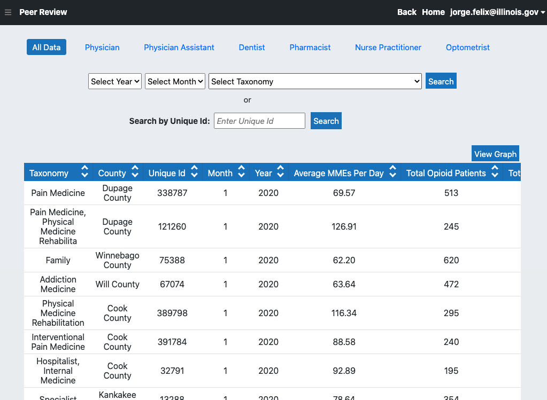

Slide 31
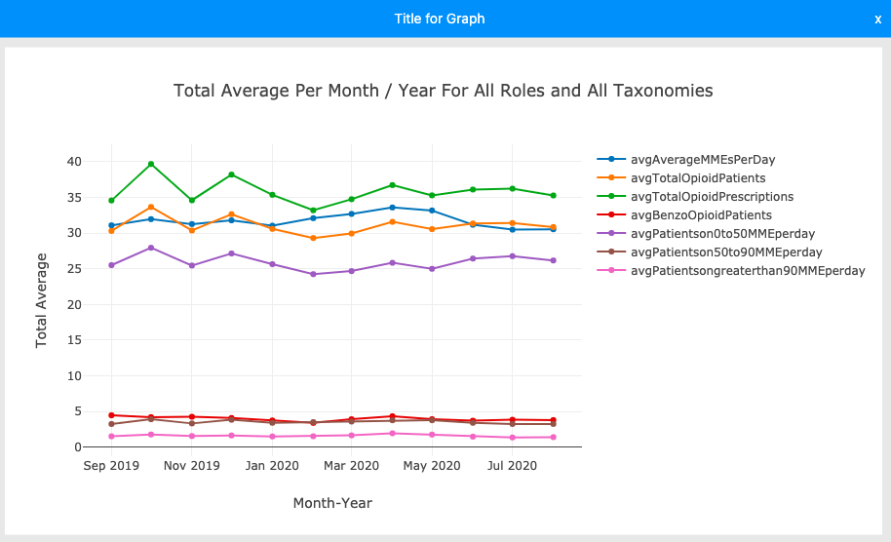

Slide 32
Open Discussion

Slide 33
Adjourn

