Slide 1
Advisory Committee Meeting
August 31, 2021

Slide 2
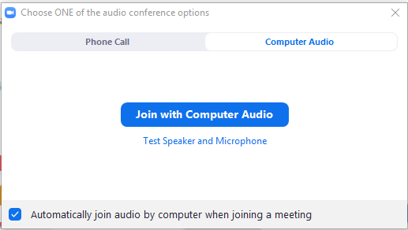
Housekeeping: Connect to Computer
Join using computer audio and a plug-in headset or computer speakers
Notes:
You can connect to audio using either Computer Audio or your telephone. To join using computer audio, click the blue “Join with Computer Audio” button. We suggest using a plug-in headset when possible for the best audio experience.

Slide 3
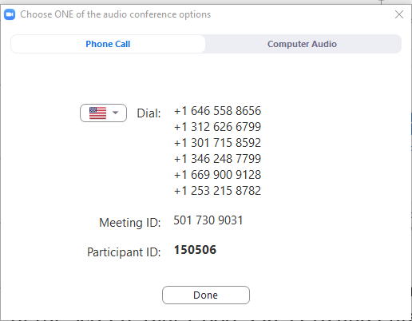
Housekeeping: Phone and Video
Join by phone: Click Join Audio, Phone Call tab, dial the desired phone number, Enter Meeting ID & Participant ID
You will begin muted. To unmute/mute click the Microphone icon
Click Start Video to join by webcam
+1 xxx-xxx-xxxx
+1 xxx-xxx-xxxx
+1 xxx-xxx-xxxx
+1 xxx-xxx-xxxx
xxx xxx xxxx
xxxxxx
Notes:
To connect by phone, click the Join Audio icon and choose the Phone Call tab. Choose a telephone number starting with the one at the top of your list and, when prompted, enter the Meeting ID and your Participant ID, which can be found in your calendar invitation.
Once you are connected, your audio will be muted. You can mute and unmute by clicking the microphone icon.
To join using your webcam, click Start Video. You can stop and re-start your Video by clicking the button.

Slide 4
Housekeeping: How to Participate
Chat: click the chat icon to open the chat panel
Hold the ctrl key and press + to increase font
Ask for help in chat box
Reactions: located at the bottom of the participant’s panel
Notes:
Feel free to use the Chat feature by clicking on the Chat icon, selecting the user to chat with, and then entering your text and hitting enter. Note that the default chat audience is Everyone.
You can also use Reactions to respond to questions and interact in the meeting. You’ll find options at the bottom of the Participants panel, including the ability to raise your hand, choose yes or no, indicate whether you’d like the speaker to go faster or slower. Click the More button to give a thumbs up or down, clap, or indicate that you need a break or have stepped away.
If you are having technical difficulties at any time, please feel free to start a private chat with BHTA-Tech and we will assist you!

Slide 5
Advisory Committee members
6 PHYSICIANS
William Campbell, DO
Kenneth Candido, MD
Ankur Dave, MD
Scott Glaser, MD
Shami Goyal, MD
David Liebovitz, MD
1 DENTIST
Edward Segal, DDS
4 PHARMACISTS
Helga Brake, Pharm D
Cara Brock, Pharm D
Chris Herndon, Pharm D
Garry Moreland, RPh
2 ADVANCED PRACTICE REGISTERED NURSES
Julie Adkins, APRN
Raechel Ferry-Rooney, APRN
1 OPTOMETRIST
Christina Morettin, OD
1 PHYSICIAN ASSISTANT
Mindy Sanders, PA

Slide 6
Welcome
Introduction
Tonya Miller, ILPMP Administrative Assistant
Approval of March 16, 2021 Meeting Minutes

Slide 7
Advisory Committee Charges – 720 ILCS 570/320
Attestation Form
3. Review and Recommend the following for inclusion or distribution
Guidelines
CME
Programs/Information
Publications
Medical Studies
4. Semi-annually review PMP website to ensure the most current available information is displayed
Opportunities for federal grants and other forms of funding to support projects
Communication to be sent to all PMP registered users
CME
Information regarding prescribing and dispensing
1. Review ILCS Act in order to determine whether changes should be recommended to the General Assembly
Review legislative proposals
Discuss position on pending legislation
Review of Administrative Rules
2. Review current drug schedules in order to manage changes to the administrative rules pertaining to the utilization of
the ILCS Act

Slide 8
Required trainings
HIPAA
Ethics
Harassment

Slide 9
New Published rules
EHR Integration 2080.207
Pharmacy Software Integration 2080.208

Slide 10
Other rules
Remaining rules submitted to JCAR
New rules being drafted to address new legislation

Slide 11
New Legislation
Public Act 102-0666
Public Act 102-0490
Public Act 102-0527

Slide 12
Public Act 102-0666
Expands EHR integration by allowing a direct one-to-one connection through a certified IT module

Slide 13
Public Act 102-0490
E-prescription mandate for C II-V
Exemption <25 prescriptions/year

Slide 14
Public Act 102-0527
OTP reporting to PMP
With patient consent
Doctor shopping threshold 5-5-6
Same day reporting

Slide 15
Proposals
All medications
Diagnosis codes/day supply
Medical administrator accounts
Reporting requirement cleanup

Slide 16
Peer Review Committee Update
Request for information letters sent to Physicians
Plan to expand to additional prescriber types
>= 90 MME/Day for each of the last 3 months reviewed
At least 10 opioid Patients
Excluding oncology, palliative care, and hospice
Online form, answers accessible to the Peer Review Committee
Next steps: identify opportunities for education or referral

Slide 17
Request for information letter
Sent to prescribers or dispensers and requests information regarding their prescribing outside the currently accepted medical standards of their professional practice
Sent via certified mail, return receipt requested
Prescriber or dispenser has 30 days to respond, 3 requests
May refer to IDFPR

Slide 18
CDC Technical Review
Encouraged to include additional guidance to clinicians identified as high prescribers to address clinical concerns around patient safety
Providers abruptly stopping opioid prescriptions
Fast tapering (for example, greater than 10% decrease per week)
Patients being dropped from care (directly)
Patients being dropped from care (indirectly) such as a primary care provider making a referral to pain specialist, but pain specialist not available in the network
Chronic pain not be managed and negative impact on patient’s function (i.E., PEG scale); illicit drug use (starting, resuming, or increasing); and suicide

Slide 19
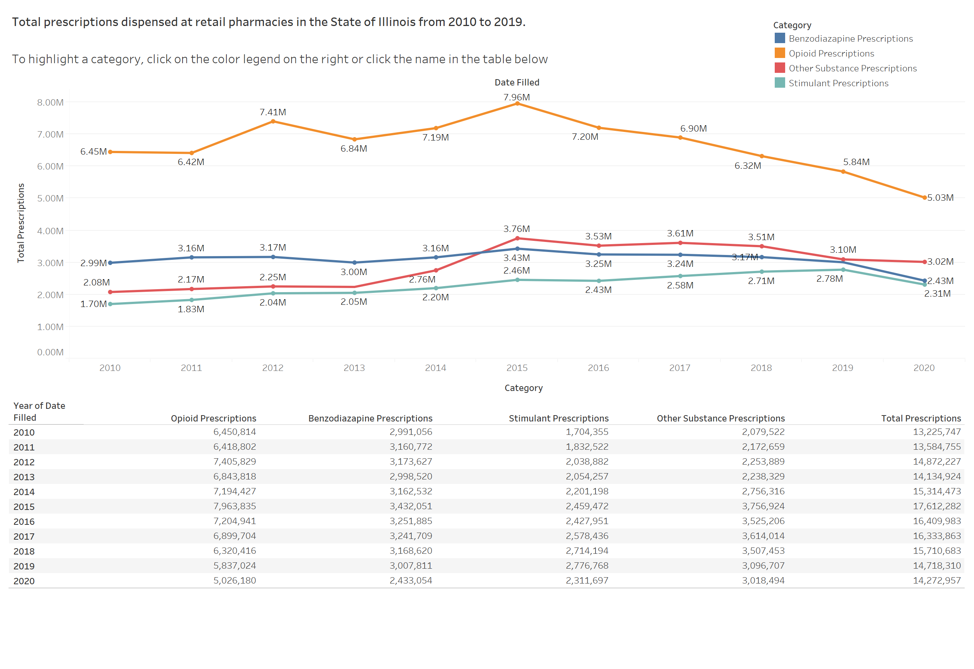
Data Dashboard update & Demo

Slide 20
OUTREACH PLAN
Association outreach
Newsletter
Website changes
Social media

Slide 21
OPEN DISCUSSION & adjournment

