Slide 1
PMP Advisory Committee
March 16, 2021

Slide 2
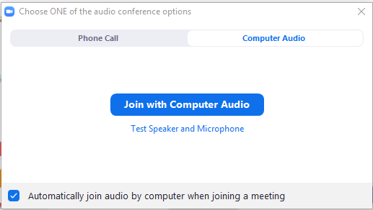
Housekeeping: Connect to Computer
Join using computer audio and a plug-in headset or computer speakers
This Photo by Unknown Author is licensed under CC BY-SA
Notes:
You can connect to audio using either Computer Audio or your telephone. To join using computer audio, click the blue “Join with Computer Audio” button. We suggest using a plug-in headset when possible for the best audio experience.

Slide 3
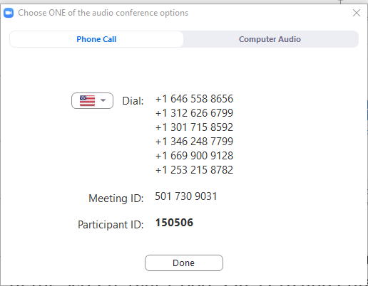
Housekeeping: Phone and Video
Instructions
Join by phone: Click Join Audio, Phone Call tab, dial the desired phone number, Enter Meeting ID & Participant ID
You will begin muted. To unmute/mute click the Microphone icon
Click Start Video to join by webcam
+1 xxx-xxx-xxxx
+1 xxx-xxx-xxxx
+1 xxx-xxx-xxxx
+1 xxx-xxx-xxxx
xxx xxx xxxx
xxxxxx
Notes:
To connect by phone, click the Join Audio icon and choose the Phone Call tab. Choose a telephone number starting with the one at the top of your list and, when prompted, enter the Meeting ID and your Participant ID, which can be found in your calendar invitation.
Once you are connected, your audio will be muted. You can mute and unmute by clicking the microphone icon.
To join using your webcam, click Start Video. You can stop and re-start your Video by clicking the button.

Slide 4
Housekeeping: How to Participate
Chat: Click the Chat icon to open the Chat panel
Hold the Ctrl key and press + to increase font
Reactions: Located at the bottom of the Participants panel
Need help? Type into the Chat box!
Notes:
Feel free to use the Chat feature by clicking on the Chat icon, selecting the user to chat with, and then entering your text and hitting enter. Note that the default chat audience is Everyone.
You can also use Reactions to respond to questions and interact in the meeting. You’ll find options at the bottom of the Participants panel, including the ability to raise your hand, choose yes or no, indicate whether you’d like the speaker to go faster or slower. Click the More button to give a thumbs up or down, clap, or indicate that you need a break or have stepped away.
If you are having technical difficulties at any time, please feel free to start a private chat with BHTA-Tech and we will assist you!

Slide 5
WELCOME
Approval of Meeting Minutes November 6th, 2020

Slide 6
PMPAC Members
Julie Adkins, APRN
Helga Brake, Pharm D
Cara Brock, Pharm D
William Campbell, DO
Kenneth Candido, MD
Ankur Dave, MD
Raechel Ferry-Rooney, APRN
Scott Glaser, MD
Shami Goyal, MD
Christopher Herndon, Pharm D
David Liebovitz, MD
Garry Moreland, RPh
Christina Morettin, OD
*Edward Segal, DDS
Mindy Sanders, PA

Slide 7
Charges of the PMPAC 720 ILCS 570/320 - Illinois General Assembly
Review
Review ILCS Act in order to determine whether changes should be recommended to the General Assembly
Review legislative proposals
Discuss position on pending legislation
Review of Administrative Rules

Slide 8
Charges of the PMPAC 720 ILCS 570/320 - Illinois General Assembly
Review
Review current drug schedules in order to manage changes to the administrative rules pertaining to the utilization of the ILCS Act

Slide 9
Charges of the PMPAC 720 ILCS 570/320 - Illinois General Assembly
Review & Recommend
Review and Recommend the following for inclusion or distribution
Guidelines
CME
Programs/ Information
Publications
Medical Studies

Slide 10
Charges of the PMPAC 720 ILCS 570/320 - Illinois General Assembly
Semi-Annual Reviews
PMP website to ensure the most current available information is displayed
Opportunities for federal grants and other forms of funding to support projects
Communication to be sent to all PMP registered users
CME
Information regarding prescribing and dispensing

Slide 11
Legislative Update
Rules
Pending Legislation
Possible Proposals

Slide 12
Administrative Rules
77 Ill. Adm. Code 2080
First Posting Complete
Section 2080.207 EHR Integration with the PMP
Section 2080.208 Pharmacy Management Systems Integration with the PMP
For Review
Section 2080.205 Accessing the PMP
Designee Access

Slide 13
SAMHSA revisions to Part 2 Regulations for the Confidentiality of SUD Patient Records
Confidentiality of Substance Use Disorder Patient Records regulations located at 42 C.F.R. Part 2

Slide 14
Revisions Related to PDMPs
Disclosure to Central Registries and PDMPs: The final rule amends the disclosure requirements to
(A) allow non-opioid treatment providers to access central registries, in order to determine whether a patient is already receiving opioid treatment; and
(B) allow opioid treatment providers to disclose dispensing and prescribing data, as required by applicable state laws, to prescription drug monitoring programs (PDMPs), subject to patient consent.

Slide 15
HB3448 HB0158 HB601 SB1842
Amends the Illinois Controlled Substances Act
Provides that opioid treatment programs (OTP’s) shall document an attempt to obtain patient consent
OTP shall not transmit information without patient consent
Reports may not be utilized for law enforcement purposes
Provides that treatment of a patient may NOT be conditioned upon their consent to reporting

Slide 16
Implementation Plan
OTP currently report methadone administration to DHS
OTP programs will add a patient consent attribute/column to the data
PMP will work with DHS to develop a method to import that data
PMP will then display the relevant data

Slide 17
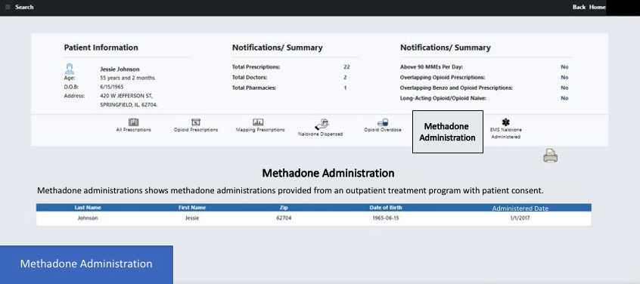
OTP Methadone Administrations

Slide 18
X-waiver Update
Health and Human Services (HHS) announced that it will publish
Practice Guidelines for the Administration of Buprenorphine for Treating Opioid Use Disorder
Eliminates the X-waiver requirement for DEA-registered physicians
Expands access to MAR for people with OUD

Slide 19
SAMHSA Clarification Statement
On January 14, 2021, HHS announced forthcoming Practice Guidelines for the Administration of Buprenorphine for Treating Opioid Use Disorder. Unfortunately, the announcement was made prematurely. Therefore, the Guidelines previously announced cannot be issued at this time. However, HHS and ONDCP are committed to working with interagency partners to examine ways to increase access to buprenorphine, reduce overdose rates and save lives.

Slide 20
HB 3596
Amends the
Illinois Controlled Substance Act
Mandates electronic prescribing of Controlled Substances

Slide 21
FY22 Proposal Ideas
Diagnosis Requirement
Real-time or same day reporting
CDC Alignment of MPE
Hospital Administrator Accounts
Public Health Access
Pharmacist Mandate
All Medications

Slide 22
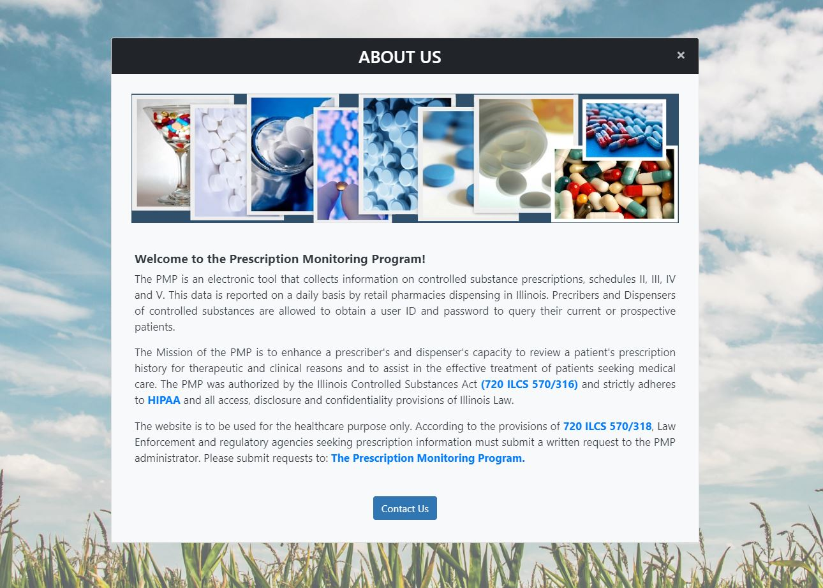
Website Update
Notes:
The PMP is a state run electronic database that tracks the prescribing and dispensing of controlled substance medications to patients in Illinois.

Slide 23
Illinois Helpline Referral Link
The Helpline is the statewide, public resource for finding substance use treatment and recovery services in Illinois.
ILPMP has implemented a direct referral link for providers to refer patients to the HELPINE for follow up with patient consent.

Slide 24
Illinois Helpline for Opioids and Other Drugs
To find substance use disorder recovery and recovery support services in Illinois, this helpline feature is added to our website.
PMP has implemented a direct referral system that will allow the prescribers to refer patients directly to the Helpline for assistance in seeking treatment resources.

Slide 25
Illinois Helpline for Opioids and Other Drugs - Form

Slide 26
PMP Dashboard
UPDATE
By:
Megshi Thakur
(Clinical Database Associate)

Slide 27
update
By:
Jen Erickson
(PMPnow Project Director)

Slide 28
40+ EHR Connections
with 90+ in the pipeline
11,000+
Individual connection points including hospitals pharmacies, physician practices, local health departments, dental, optical, long term care facilities, and treatment centers.
6,800 + in progress!
100,000+
Potential Healthcare Professionals Have Access

Slide 29
Website & PMPnow Searches 2015 - 2020
Year | PMPnow Connections
2015 | 32
2016 | 84
2017 | 185
2018 | 493
2019 | 3670
2020 | 8726

Slide 30
Additional PMP Projects highlighted
IANS

Slide 31
Injury and Accident Notification System
IANS
PROPOSAL
BACKGROUND
Updates to website and PMPnow to visually alert users to possible overdose history
Additional data sets:
ICD -10
&
Limited medication administration data
Opportunity for pilot participants to provide feedback with development
RATIONALE/KEY SUCCESS FACTORS
UPSIDE POTENTIAL
Funding is available to assist facilities with integration and development!
RISK OR ALTERNATIVES

Slide 32
Peer Review February 2, 2021
New Data format Live
Review of Committee Charges
One on One meetings

Slide 33
Call to action
Request Feedback
Additional data for display
Suggested visualizations
Ways to provide more meaningful data
Improving functionality

Slide 34
Open Discussion

Slide 35
Adjourn

