Slide 1
Advisory Committee Meeting
March 22, 2022

Slide 2
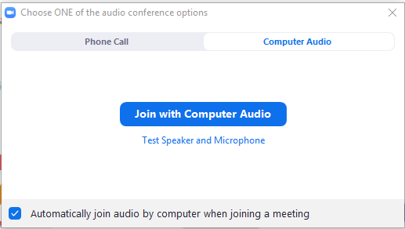
Housekeeping: Connect to Computer
Join using computer audio and a plug-in headset or computer speakers
Notes:
You can connect to audio using either Computer Audio or your telephone. To join using computer audio, click the blue “Join with Computer Audio” button. We suggest using a plug-in headset when possible for the best audio experience.

Slide 3
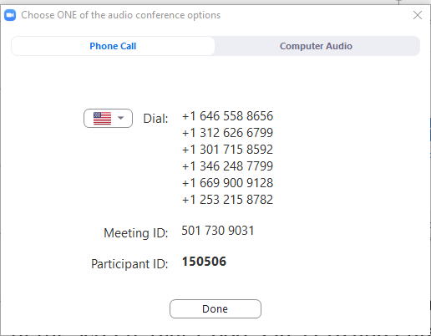
Housekeeping: Phone and Video
Join by phone: Click Join Audio, Phone Call tab, dial the desired phone number, enter Meeting ID & Participant ID
You will begin muted. Click Unmute to unmute/mute
Click Start Video to join by webcam
+1 xxx-xxx-xxxx
+1 xxx-xxx-xxxx
+1 xxx-xxx-xxxx
+1 xxx-xxx-xxxx
xxx xxx xxxx
xxxxxx
Notes:
To connect by phone, click the Join Audio icon and choose the Phone Call tab. Choose a telephone number starting with the one at the top of your list and, when prompted, enter the Meeting ID and your Participant ID, which can be found in your calendar invitation.
Once you are connected, your audio will be muted. You can mute and unmute by clicking the microphone icon.
To join using your webcam, click Start Video. You can stop and re-start your Video by clicking the button.

Slide 4
Housekeeping: How to Participate
Chat: Click Chat to open the chat panel
Hold the ctrl key and press + to increase font
Reactions: Located at the bottom of the participant’s panel
Need help? Type into the chat box
Notes:
Feel free to use the Chat feature by clicking on the Chat icon, selecting the user to chat with, and then entering your text and hitting enter. Note that the default chat audience is Everyone.
You can also use Reactions to respond to questions and interact in the meeting. You’ll find options at the bottom of the Participants panel, including the ability to raise your hand, choose yes or no, indicate whether you’d like the speaker to go faster or slower. Click the More button to give a thumbs up or down, clap, or indicate that you need a break or have stepped away.
If you are having technical difficulties at any time, please feel free to start a private chat with BHTA-Tech and we will assist you!

Slide 5
ILPMP Advisory Committee Meeting
March 22, 2022 12:00 – 1:30 p.m. Central
Welcome - Dr. David Liebovitz
Introduction of Dr. Erica Ittner
Approval of August 31, 2021 Meeting Minutes
Changes to CDC Guidelines
Performance Audit Update
Legislative Update
Peer Review Committee Update
Outreach
Website
Open Discussion
Adjournment
AGENDA

Slide 6
Advisory Committee members
6 PHYSICIANS
William Campbell, DO
Kenneth Candido, MD
Ankur Dave, MD
Scott Glaser, MD
Shami Goyal, MD
David Liebovitz, MD
1 DENTIST
Edward Segal, DDS
4 PHARMACISTS
Helga Brake, Pharm D
Cara Brock, Pharm D
Chris Herndon, Pharm D
Garry Moreland, RPh
2 ADVANCED PRACTICE
REGISTERED NURSES
Raechel Ferry-Rooney, APRN
Vacant
1 OPTOMETRIST
Erica Ittner, OD
1 PHYSICIAN ASSISTANT
Mindy Sanders, PA

Slide 7
In Memoriam
Julie Adkins, DNP, APN, FNC-BC, FAANP
West Frankfort, IL
June 20, 1954- February 5, 2022

Slide 8
Introduction – Dr. Erica Ittner
Welcome Erica Ittner, OD, FAAO, to the Advisory Committee and Peer Review Committee. Dr. Ittner graduated from Illinois College and is an Associate Professor at Illinois College of Optometry and Associate Optometrist at Hawthorn Woods Family Eye Care and the Illinois Eye Institute in Chicago. She is a member of the Illinois Optometric Association, American Optometric Association and a fellow of the American Academy of Optometry.

Slide 9
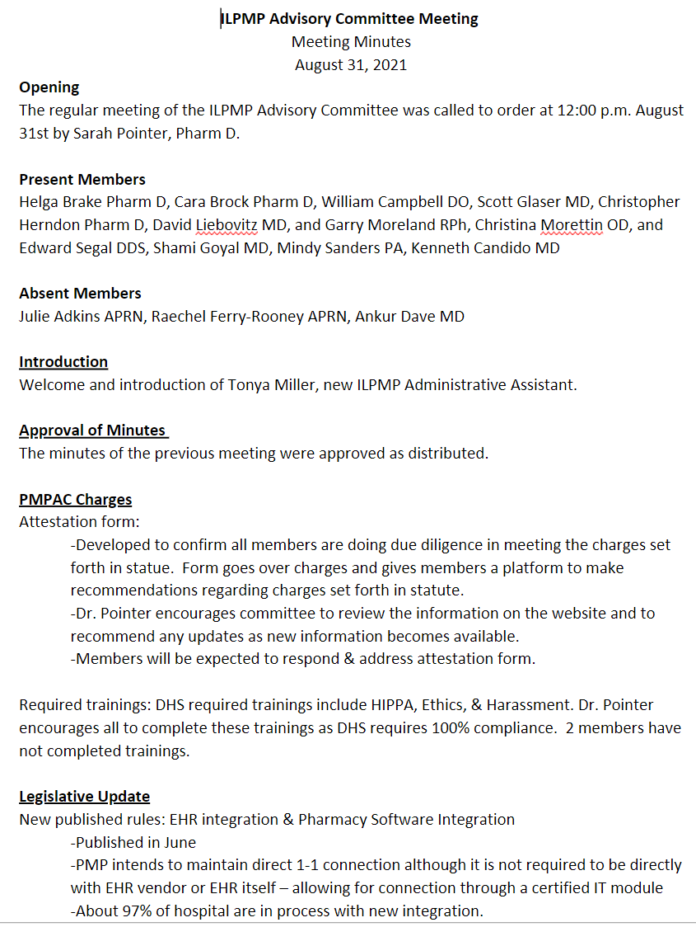
Approval of August 31, 2021 Meeting Minutes

Slide 10
Changes to the CDC Guidelines
Eric Huff, PharmD
Clinical Project Manager
Updating the 2016 CDC Guideline for Prescribing Opioids for Chronic Pain
Link distributed to Advisory Committee members February 18th
https://www.federalregister.gov/public-inspection/2022-02802/proposed-2022-clinical-practice-guideline-for-prescribing-opioids
60 Day Public Comment period ends April 11, 2022
Notes:
•There are now 4 main sections
•Selection & Dosage + Duration & Follow-Up were all in the same section in 2016
•There is a focus on: DO NOT apply as inflexible standard of care across patient population
•Still using ACIP GRADE (Grading of Recommendations Assessment, Development, and Evaluation) framework for systematic review of scientific literature
•Category A=most patients should receive recommended action
•Category B=different choices appropriate for different patients

Slide 11
Changes to the CDC Guidelines
Sickle Cell Disease added to exclusions list
Broader primary care clinician base
Scope now includes patients with acute or subacute pain
Substantially expanded use for acute pain & tapering
Taper 10%/month vs 10%/week for long-term patients
Expanded non-opioid & non-pharmacological recommendations
Notes:
•Sickle Cell Dz was added to the exclusion list
•Broader scope of clinicians, vs 2016 only focusing on primary care physicians
•Physicians, nurse practitioners, physician assistants, and oral health practitioners, surgeons, emergency clinicians, occupational medicine, physical medicine, rehabilitation clinicians, neurologists
•Scope now includes acute & subacute pain, in addition to chronic pain (>3mo or past normal tissue healing) in 2016
•This update includes expanded subacute definition and management info
•Acute (< 1 month), Subacute (1-3months)
•Substantially expanded acute pain & taper recommendations
•Tapers of ~10%/month or slower vs 10%/week
•4-7 days taper 50% daily for 2 days
•7-30 days taper ~20% dosage every 2 days
•More robust recommendations for non-opioid & non-pharm therapies
•Heat therapy or NSAIDs for low back pain
•Weight loss, exercise, and topical NSAIDs for knee osteoarthritis

Slide 12
Changes to the CDC Guidelines
Specified starting dose for opioid naïve patients
Single dose of ~5-10 MME
Daily dose of 20-30 MME/day
Removed specific dosage thresholds
Remove ≤ 3-day supply recommendation for acute pain
Added 2-week minimum follow-up if continuing opioids for acute pain
Clinicians should consider toxicology testing
Notes:
Specified starting dose for opioid naïve patients (Table of dosing equivalents will be included)
Single dose approx 5-10 MME
OR - Daily dose ~20-30 MME
Removed specific dosage thresholds so as not to be “authoritative” absolute values
Exceeding 50 MME/day likely to yield diminishing returns
Removed ≤ 3 day supply recommendation for acute pain
Now recommend a minimum of 2 week F/U if continuing opioids for acute pain
If continued opioid use >1 month = refer to subacute recommendation
Clinicians should CONSIDER tox screening for subacute & chronic pain
Consider before, and periodically
2016 recommended urine drug test before starting & consider (at least) annual testing

Slide 13
Changes to the CDC Guidelines
Buprenorphine/Methadone for opioid use disorder should not be withheld from patients on Benzodiazepine/CNS depressant
Added DSM-5 criteria for diagnosing opioid use disorder directly into guideline
PDMP access frequency for long-term opioid patients no longer a disagreement with expert opinions*
90 MME/day verbiage has been removed
Notes:
Greatly expanded opioid use disorder treatment section
Dosing
Clinicians able to administer once daily x 3 days of buprenorphine/methadone while referring patient to OTP facility
Clarified recommendation that buprenorphine & methadone should NOT be withheld from PT with benzos or other CNS depressants
PMP use frequency no longer in disagreement with expert opinions
2016 guidelines still had disagreements (probably from acceptance)
This one was just a positive for the PMP staff
DSM-5 criteria directly posted in guidelines
Was simply linked in 2016
90 MME/day verbiage is virtually gone
Only referenced in regards to two studies (risks of 50-90 MME/day, and tapering)

Slide 14
Performance Audit Update
Notes:
Greatly expanded opioid use disorder treatment section
Dosing
Clinicians able to administer once daily x 3 days of buprenorphine/methadone while referring patient to OTP facility
Clarified recommendation that buprenorphine & methadone should NOT be withheld from PT with benzos or other CNS depressants
PMP use frequency no longer in disagreement with expert opinions
2016 guidelines still had disagreements (probably from acceptance)
This one was just a positive for the PMP staff
DSM-5 criteria directly posted in guidelines
Was simply linked in 2016
90 MME/day verbiage is virtually gone
Only referenced in regards to two studies (risks of 50-90 MME/day, and tapering)

Slide 15
RECOMMENDATION #1: The Department of Human Services should fully implement an ILPMP in accordance with State requirements by ensuring all EHRs are fully interfaced with the ILPMP, as required.
PMPnow | February 2017 | February 2022
Unique Healthcare Entities/Organizations Connected | 11 | 1,279
Individual Connection Points Live | 11 | 13,093
Queries Performed | 596,846 | 7,452,446
Electronic Health Record/Pharmacy Management Vendors/Live | 3 | 72
Redefine All HER's
Identify measurable denominator
Clarify onus of compliance

Slide 16
RECOMMENDATION #8: The Department of Human Services should ensure all prescribers possessing an Illinois Controlled Substance License are registered with the ILPMP as required by the Illinois Controlled Substance Act.

Slide 17
RECOMMENDATION #11: The department of human services should address the identified ILPMP committee weaknesses by:
Ensuring rules align with statute.
PMPAC charges outlined by the act should be completed, as required.
PRC members with the same profession as the prescribers or dispensers being reviewed are preparing preliminary reports and/or making recommendations, as required by the act.
PRC annual report requirements
Follow-up on at-risk prescribers

Slide 18
Legislative update
SB 2535
SB 3024
HB 5491
PA 102-0490
SB 3920
PA 102-0527

Slide 19
PA 102-0490
E-prescription mandate for CS II-V​
Exemption <25 Prescriptions/Year
Effective 1/1/23

Slide 20
PA 102-0527
OTP reporting to ILPMP
Effective 8/20/21
ILPMP/SUPR Collaboration
Consent Form Drafted
Public Act 102-0527

Slide 21
OTP DATA Display

Slide 22
SB 3920
PMP Omnibus Bill
Diagnosis Codes
All Meds Reporting
Medical Director Accounts
Change in Reporting Requirements
SB 3920

Slide 23
SB 3024
Allows public health access to identifiable ILPMP data
SB 3024
Awaiting floor action

Slide 24
HB 5491
Adds Clonazolam as a Schedule IV Controlled Substance
HB 5491
Dead
Notes:
dead

Slide 25
SB 2535
Prescriber: notify patients of risk of addiction
Hospital: dispense naloxone
Pharmacist: offer to dispense naloxone
SB 2535
Awaiting committee action

Slide 26
Attestation form Comments
Review and recommend changes to the
Illinois Controlled Substances Act:
Replace "Addict“ with:
"Person who uses substances"
“Person who uses drugs"
“Person with substance use disorder”
Review and recommend changes
to the Administrative Rules:
In Section 2080.240 Mid-Level Practitioners’ Reporting amendment

Slide 27
Peer review committee update
22 - Request for Information Letters Sent
17 - No Further Action
2 - Additional Information Requested
3 - Referrals to IDFPR

Slide 28
Outreach
Constant Contact
Quarterly Newsletters
News/Information
Educational Resources
Statistics
Legislation
Monthly Updates
Associations and Other Contacts

Slide 29
Website

Slide 30
Website
Review and recommend the following for inclusion or distribution:
Guidelines
CME
Programs/Info
Publications
Medical Studies
Recommendations from Attestation form:
ASIPP Competency Certification in Controlled Substance Management
https://www.drugabuse.gov/nidamed-medical-health-professionals/health-professions-education/cmece-activities
https://elearning.asam.org/products/pain-management-opioids-balancing-risks-benefits-updated-25-cme#tab-product_tab_overview
https://health.gov/our-work/national-health-initiatives/health-care-quality/trainings-resources/pathways-safer-opioid-use
https://tceols.cdc.gov/ (search "opioid" there are a lot of modules)
https://pcssnow.org/education-training/
https://end-overdose-epidemic.org/awareness/education/

Slide 31
Website
Other recommendations:
National Organization of State Offices of Rural Health
https://nosorh.org/rural-opioid-resources/
AHRQ The Academy
Substance use resources, including Medication Assisted Treatment (MAT)
https://integrationacademy.ahrq.gov/products/substance-use-resources
CME website:
American Society of Addiction Medicine (ASAM)
Offers multiple CME courses on substance use disorder and addiction treatment
https://elearning.asam.org/substance

Slide 32
NASCSA Survey
NASCSA (National Association of States Controlled Substance Authority) conducted a survey related to Gabapentin. Public Citizen has filed a Citizens Petition requesting the drug be listed as a Schedule V Controlled Substance.
Does your state schedule Gabapentin? No
Does your state utilize the Illinois Prescription Monitoring Program to monitor prescribing and dispensing of Gabapentin? Yes
Are Gabapentin and Gabapentin drugs of concern in your state? Yes
Do you recommend that NASCSA provide the results of this survey to the Food & Drug Administration (FDA) and other agencies?
Do you support the placement of Gabapentin as a Schedule V Controlled Substance federally?

Slide 33
Reminder
Ethics, Harassment and Discrimination Prevention, HIPPA and Privacy, and Security Awareness Training is open. Training due by May 1.

Slide 34
OPEN DISCUSSION & adjournment

