Slide 1
PMP Advisory Committee
October 15, 2019

Slide 2
Housekeeping
Mute phones
Do not place call on hold
Identify yourself

Slide 3
AGENDA
Roll Call
Meeting Minutes 07/16/2019

Slide 4
Peer Review Committee July 31st, 2019
Introduction of New Members
Review of Charges
Data Revision
High Prescriber Letters
Access to Data
Next Meeting Pending Doodle Poll

Slide 5
Legislative Update
Amendments Passed
Pending Legislation
Current Proposals

Slide 6
Approved Legislation
Public Act 101-0414 (SB 1665)
Exempting Veterinarians from the utilization mandate for the PMP, as well as the requirement for membership on the PMP Advisory Committee and Peer Review Committee
Requires reporting of suspected fraudulent activity to law enforcement

Slide 7
Pending Legislation
HB 0163- real-time reporting and PMP fund
HB 3889- Requires Opioid Treatment Programs report to the PMP
Dependent on the amendment 42 CFR Part 2

Slide 8
Proposed Legislation PMP proposals submitted to DHS Legislation
Change the Multiple Provider Episode threshold from 3-3-1 to 5-5-6
Change the reporting requirement to the PMP from all Controlled Substance II-V to include all prescription medications

Slide 9
Nebraska’s PDMP: Past, Present and Future
Kevin C. Borcher, PharmD
PDMP Program Director, NEHII

Slide 11
CDC- Overdose Data to Action
By Craig Berberet
PMP Administrator

Slide 12
CDC Overdose Data to Action Grant Award
Collaboration with Department of Public Health
Three Year Grant
Strategies
PMP Enhancements
Integration of State and Local Prevention Response Efforts
Establishing Linkages to Care
Providers and Health Systems Support
Partnerships with Public Safety and First Responders

Slide 13
PMP Enhancements
Increase Delegate Access
Real-time Reporting
Increase MyPMP Usage
Increase PMPnow Connections

Slide 14
Integration of State and Local Prevention Response Efforts
Prescriber Education
Identify prescribing and overdose risk indicators
Provide technical assistance to local health departments
Create and send alerts to PMP users
Provide county-based data on website

Slide 15
Establishing Linkages to Care
Create Opioid Treatment Referral System Utilizing PMP
View nearby treatment centers
Create reservations
View waiting lists
Develop Accident or Sports Injury Alert System
Design secure communication system for PMP users

Slide 16
Providers and Health Systems Support
Integrate Clinical Decision Support Tools
Prescribe immediate-release opioids when starting chronic pain therapy
Consider Morphine Milligram Equivalents when prescribing
Query PMP upon writing prescription
Avoid concurrent opioid and benzodiazepine prescriptions
Expand Academic Detailing
Design provider focused reports
Education and Training in high-burden counties
Public Awareness Campaign

Slide 17
Partnerships with Public Safety and First Responders
Disseminate timelier data
Partner with healthcare associations
Circulate educational materials
Support pharmacies, hospitals and providers

Slide 18
FY20 Funding
GRF
CDC ODA Grant
Harold Rogers 2019
HiTech
SOR 2019

Slide 19
IT update
New Website Go-Live November 22nd
PMPnow – 206 health systems, 456 connections, with over 10,000 sites connected
PMPnow Queries in September= 5,284,833
LogiCoy App scheduled release January 2020
Request for action

Slide 20
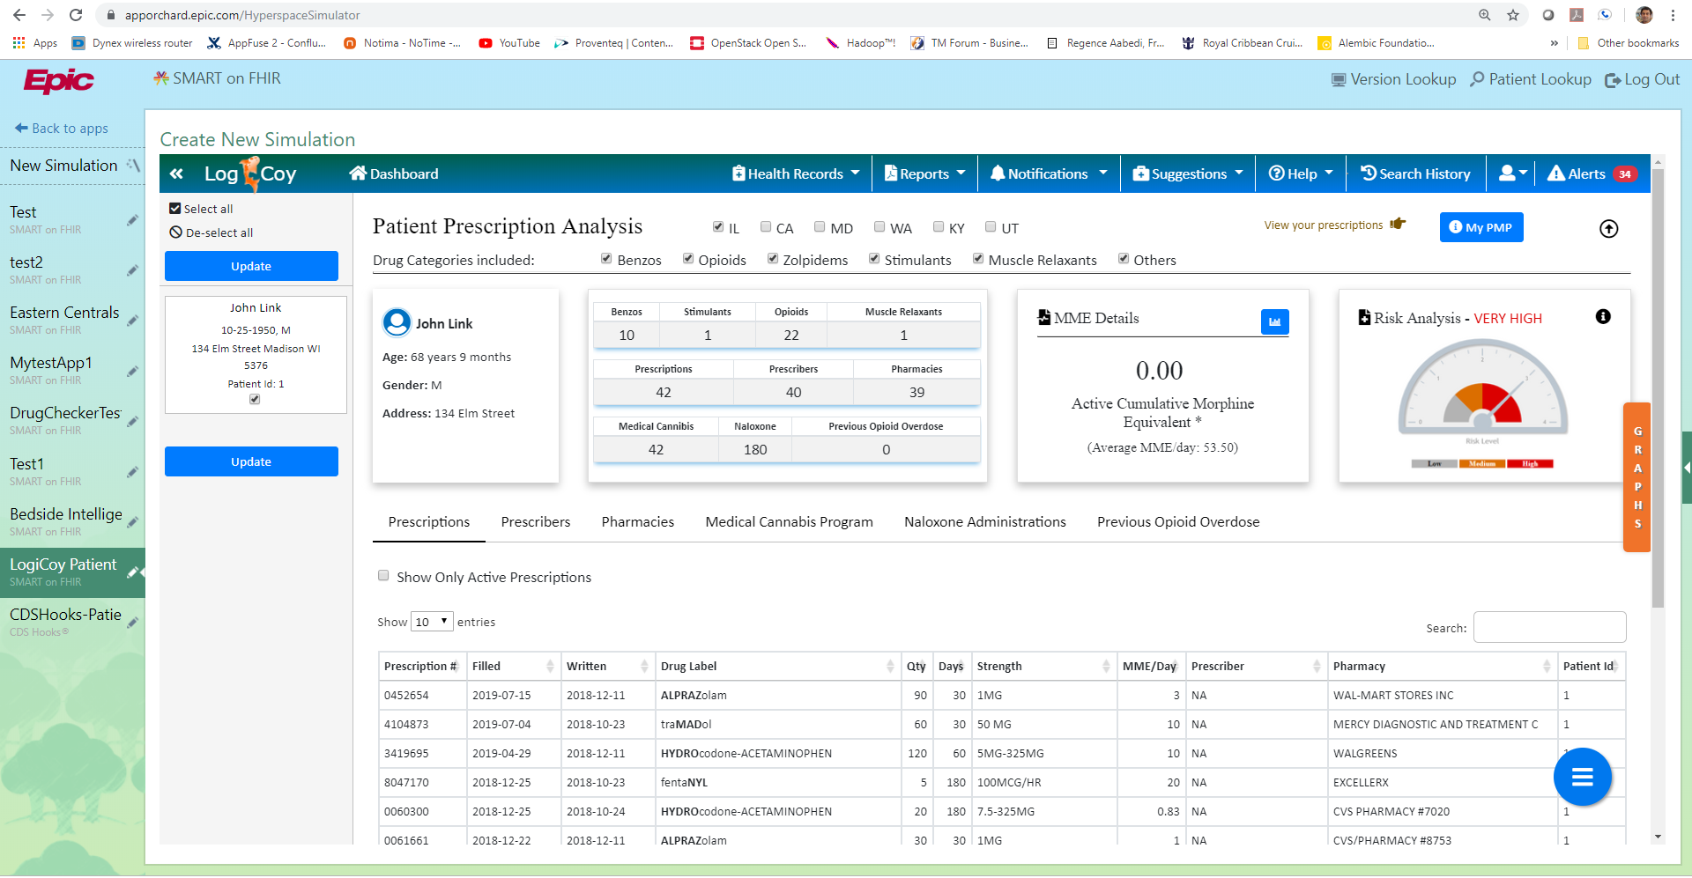

Slide 21
Focused Workgroup
Doodle Poll Coming

Slide 22
Open Discussion

Slide 23
Next Meeting
Wednesday January 15, 2020

Slide 24
Adjourn

