Slide 1






PMP Advisory Committee
July 16, 2019

Slide 2
Housekeeping
Mute phones
Do not place call on hold
Identify yourself

Slide 3
AGENDA
Roll Call
Meeting Minutes 03/20/19

Slide 4
DHS required Annual Training
Annually Trainings 2019
DHS Ethics
Sexual Harassment Prevention

Slide 5
Jennifer Aring jennifer.aring@illinois.gov
OCAPS Director

Slide 6
PMP IT staffing update
Jorge Felix – Jorge.felix@illinois.gov

Slide 7
Peer Review
  Scheduled for July 30th

Slide 8
Update on Academic Detailing Activities
Todd A. Lee
July 15, 2019

Slide 9
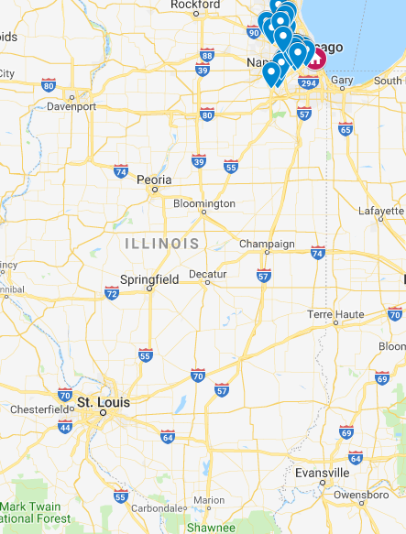
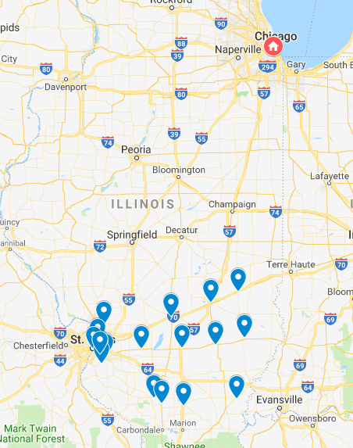

Illinois Opioid AD Program Implementation
Implemented across two phases
Phase I:
Urban Providers
Phase II:
Rural Providers
June 2018 – August 2018
November 2018 – Present
Notes:
In my presentation I will:
Take us through a brief history lesson on the evolution of pharmacy practice
Highlight some policies that contribute to its development
And finally, present the results of the our systematic review

Slide 10
AD Program Summary
Complete 2 visits with primary care providers (MD, DO, NP, PA)
  Visit length between 15 and 30 minutes
  2 visits separated by 6 to 8 weeks
Content development
  Focused on CDC prescribing guidelines
  Tailored to needs of providers
  Prescriber-specific data
Detailer training
  NaRCAD train-the-trainer model
  Quality assurance and troubleshooting
Evaluation
  Effect of the AD
  Development of AD tools
Notes:
In my presentation I will:
Take us through a brief history lesson on the evolution of pharmacy practice
Highlight some policies that contribute to its development
And finally, present the results of the our systematic review

Slide 11

CDC Guidelines Key Messages
1. Opioids are not first-line therapy
2. Establish goals for pain and function
3. Discuss risks and benefits
4. Use immediate-release opioids when starting
5. Use the lowest effective dose
6. Prescribe short durations for acute pain
7. Evaluate benefits and harms frequently
8. Use strategies to mitigate risk
9. Review PDMP Data
10. Use urine drug testing
11. Avoid opioids and benzodiazepine co-prescribing
12. Offer treatment for opioid use disorder
Red = Key messages covered
Notes:
In my presentation I will:
Take us through a brief history lesson on the evolution of pharmacy practice
Highlight some policies that contribute to its development
And finally, present the results of the our systematic review

Slide 12
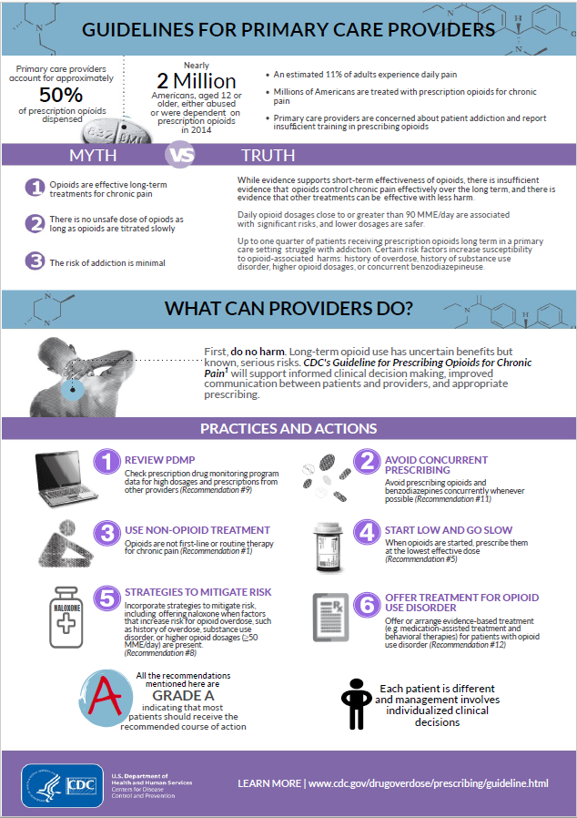
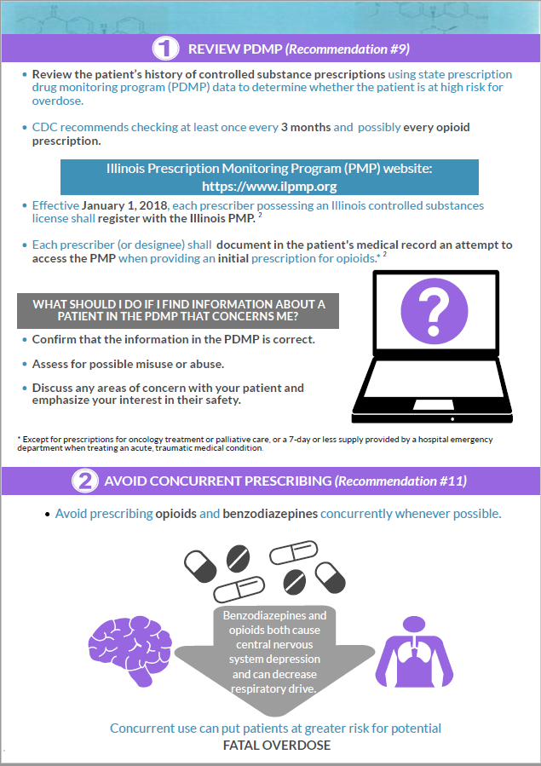
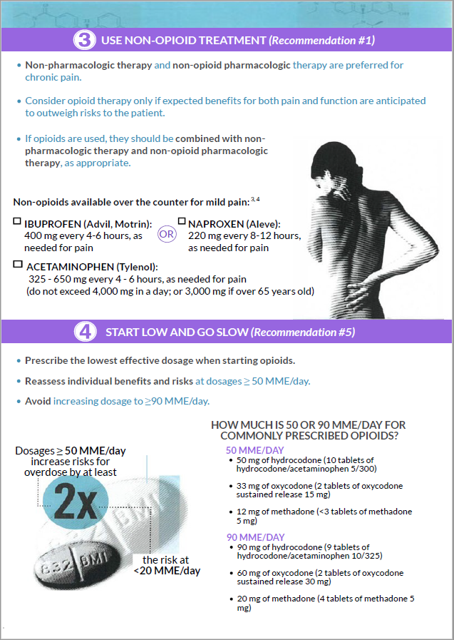
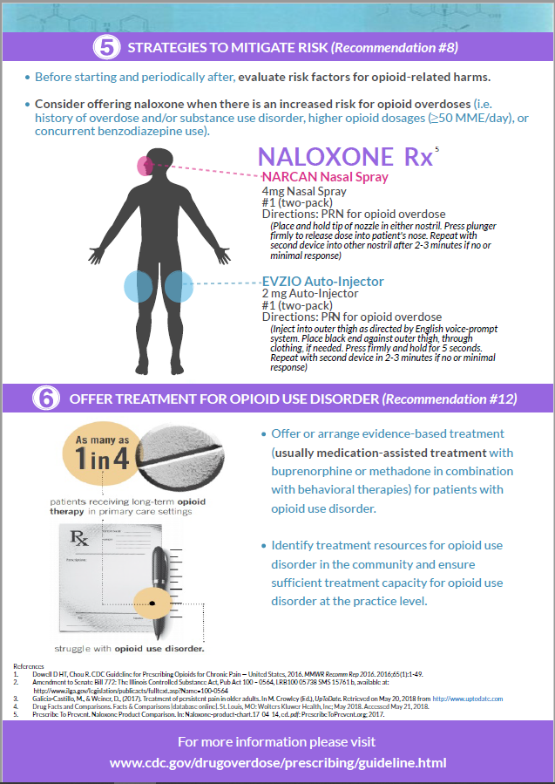
Notes:
In my presentation I will:
Take us through a brief history lesson on the evolution of pharmacy practice
Highlight some policies that contribute to its development
And finally, present the results of the our systematic review

Slide 13

Provider-specific Information
Audit and feedback is a widely used strategy to motivate behavior change
Feedback on provider clinical performance was provided via opioid prescribing information
Provider-specific opioid prescribing information was obtained from the IL PMP
Detailers shared this information with providers at each visit
Notes:
In my presentation I will:
Take us through a brief history lesson on the evolution of pharmacy practice
Highlight some policies that contribute to its development
And finally, present the results of the our systematic review

Slide 14
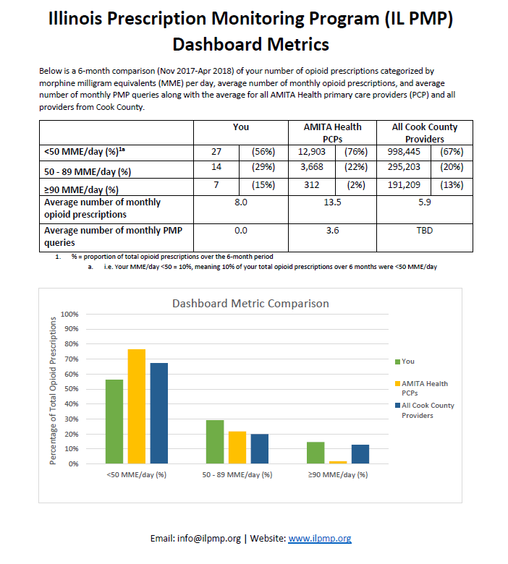
Notes:
In my presentation I will:
Take us through a brief history lesson on the evolution of pharmacy practice
Highlight some policies that contribute to its development
And finally, present the results of the our systematic review

Slide 15
Quality Assurance Process
Detailers documented visits in field notes
Field notes reviewed by program coordinators
Weekly detailer phone calls
Provider satisfaction measure
Notes:
In my presentation I will:
Take us through a brief history lesson on the evolution of pharmacy practice
Highlight some policies that contribute to its development
And finally, present the results of the our systematic review

Slide 16
Second Visit Differences in Delivery
Key difference in delivery of second visit
In-person vs. technology-based
Notes:
In my presentation I will:
Take us through a brief history lesson on the evolution of pharmacy practice
Highlight some policies that contribute to its development
And finally, present the results of the our systematic review

Slide 17
Providers Visited in Urban and Rural Sites
Phase I: Urban Providers
Phase II: Rural Providers
Provider characteristics
Total Providers, n | 186
Sex, n (%)
Female | 103 | (55.4)
Male | 83 | (44.6)
Years of Practice, mean (SD)
Mean | 14.6 | (12.0)
Provider Type, n (%)
MD/DO | 160 | (86.0)
PA/NP | 26 | (14.0)
Provider characteristics
Total Providers, n | 119
Sex, n (%)
Female | 56 | (47.0)
Male | 63 | (53.0)
Years of Practice, mean (SD)
Mean | 13.8 | (11.0)
Provider Type, n (%)
MD/DO | 76 | (63.9)
PA/NP | 43 | (36.1)
Notes:
In my presentation I will:
Take us through a brief history lesson on the evolution of pharmacy practice
Highlight some policies that contribute to its development
And finally, present the results of the our systematic review

Slide 18
Provider Satisfaction Measure Results
Item* | Urban | Rural
This is an important topic | 97% | 100%
The detailer was knowledgeable | 93% | 100%
The detailer was an effective communicator | 96% | 100%
The key messages are feasible to implement in my practice | 89% | 94%
My practice is likely to change as a result of this visit | 49% | 69%
I would be receptive to future visits | 78% | 94%
*Response options: “not at all”, “slightly”, “moderately”, “very”, or “extremely”. The results reported are for “very” or “extremely” responses
Notes:
In my presentation I will:
Take us through a brief history lesson on the evolution of pharmacy practice
Highlight some policies that contribute to its development
And finally, present the results of the our systematic review

Slide 19
Preliminary Evaluations
Change in mean monthly number of:
  Total opioid prescriptions
  High dose opioid prescriptions (>90 MME/day)
  Patients co-prescribed opioids and benzodiazepines
Outcomes measured at six months post-AD program implementation (September 2018 to February 2019)
Comparison groups: Academic detailing vs. No academic detailing
Used Difference-in-Difference approach to compare two groups before and after AD visits
Notes:
In my presentation I will:
Take us through a brief history lesson on the evolution of pharmacy practice
Highlight some policies that contribute to its development
And finally, present the results of the our systematic review

Slide 20
Preliminary Evaluations
Table 1. Baseline demographics comparison between AD-Exposed and AD-Unexposed providers in the Urban region
n (%) | Overall |  | AD-Exposed |  | AD-Unexposed
 | 550 |  | 151 | (27.5%) | 399 | (72.5%)
Sex
Female | 286 | (52.0%) | 88 | (58.3%) | 198 | (49.6%)
Male | 264 | (48.0%) | 63 | (41.7%) | 201 | (50.4%)
Years of Practice
Median (interquartile range) | 19 | (17) | 18 | (15) | 19 | (17)
Provider Type
MD | 423 | (76.9%) | 87 | (57.6%) | 336 | (84.2%)
DO | 74 | (13.5%) | 38 | (25.2%) | 36 | (9.0%)
NP | 34 | (6.2%) | 18 | (11.9%) | 16 | (4.0%)
PA | 19 | (3.5%) | 8 | (5.3%) | 11 | (2.8%)
Provider Specialty
Family Medicine | 228 | (41.5%) | 115 | (76.2%) | 113 | (28.3%)
Internal Medicine | 322 | (58.5%) | 36 | (23.8%) | 286 | (71.7%)
Notes:
In my presentation I will:
Take us through a brief history lesson on the evolution of pharmacy practice
Highlight some policies that contribute to its development
And finally, present the results of the our systematic review

Slide 21
Preliminary Outcomes
Table 2. Difference-in- Difference Estimates for Mean Monthly Total Opioid Prescriptions per Provider
 | Pre-AD Mean | Post-AD Mean | D-I-D Estimator | 95% CI | P-value
AD-exposed | 15.22 | 15.51 | -0.85 | (-1.36, -0.33) | 0.001
AD-unexposed | 13.86 | 15.00
Interpretation:
On average, nearly 1 less opioid prescription per month per provider were dispensed among AD-exposed providers relative to AD-unexposed providers
This translates to ~1,500 fewer opioid prescriptions dispensed annually (Ex: -0.85 opioid prescriptions x 151 AD-exposed providers x 12 months = ~1,500 fewer opioid prescriptions)
Notes:
In my presentation I will:
Take us through a brief history lesson on the evolution of pharmacy practice
Highlight some policies that contribute to its development
And finally, present the results of the our systematic review

Slide 22
Preliminary Outcomes (Cont’d)
Table 3. Difference-in- Difference Estimates for Mean Monthly High-dose Opioid Prescriptions per Provider
 | Pre-AD Mean | Post-AD Mean | D-I-D Estimator | 95% CI | P-value
AD-exposed | 0.86 | 0.55 | -0.11 | (-0.24, 0.01) | 0.08
AD-unexposed | 1.10 | 0.90
Interpretation:
On average, 0.11 fewer high-dose opioid prescriptions per month per provider were dispensed among AD-exposed providers relative to AD-unexposed providers
This translates to ~200 fewer high-dose opioid prescriptions dispensed annually (Ex: -0.11 opioid prescriptions x 151 AD-exposed providers x 12 months = ~ 200 fewer high-dose opioid prescriptions)
Notes:
In my presentation I will:
Take us through a brief history lesson on the evolution of pharmacy practice
Highlight some policies that contribute to its development
And finally, present the results of the our systematic review

Slide 23
Preliminary Outcomes (Cont’d)
Table 4. Difference-in- Difference Estimates for Mean Monthly Patients Co-Prescribed Opioids and Benzodiazepines
 | Pre-AD Mean | Post-AD Mean | D-I-D Estimator | 95% CI | P-value
AD-exposed | 3.68 | 3.36 | -0.22 | (-0.41, -0.04) | 0.02
AD-unexposed | 3.31 | 3.21
Interpretation:
On average, 0.22 fewer patients were co-prescribed benzodiazepines and opioids per month per provider among AD-exposed providers relative to AD-unexposed providers
This translates to ~400 fewer patients co-prescribed benzodiazepines and opioids annually (Ex: -0.22 patients co-prescribed benzodiazepines and opioids x 151 AD-exposed providers x 12 months = ~ 400 fewer patients co-prescribed benzodiazepines and opioids)
Notes:
In my presentation I will:
Take us through a brief history lesson on the evolution of pharmacy practice
Highlight some policies that contribute to its development
And finally, present the results of the our systematic review

Slide 24
Implications
Establishing partnerships are crucial for implementation of strategies to achieve initiatives that address the opioid epidemic
AD was effective at reducing the number of opioid prescriptions and patients co-prescribed benzodiazepines and opioids among AD-exposed providers relative to AD-unexposed providers
Future efforts should include scaling-up of opioid-related AD programs for delivery to other relevant providers (surgeons, dentists, etc.) across the state
Notes:
In my presentation I will:
Take us through a brief history lesson on the evolution of pharmacy practice
Highlight some policies that contribute to its development
And finally, present the results of the our systematic review

Slide 25
Next Steps
Evaluate AD program in southern Illinois
Continue evaluating the impact of the AD initiative on changes in opioid prescribing rates, duration of days supply, and accessing the PMP
Explore opportunities for continuation and expansion of our AD initiatives
Evaluate additional impacts of AD through endpoints such as naloxone prescribing, opioid-related hospitalizations, opioid-related deaths
Notes:
In my presentation I will:
Take us through a brief history lesson on the evolution of pharmacy practice
Highlight some policies that contribute to its development
And finally, present the results of the our systematic review

Slide 26
Additional Activities
Collaboration with the Illinois Department of Public Health
Conducted pilot initiative to educate community pharmacists about Naloxone standing order
Created pharmacists guide and patient resource
Used pharmacists to conduct visits with community pharmacists in Cook county

Slide 28
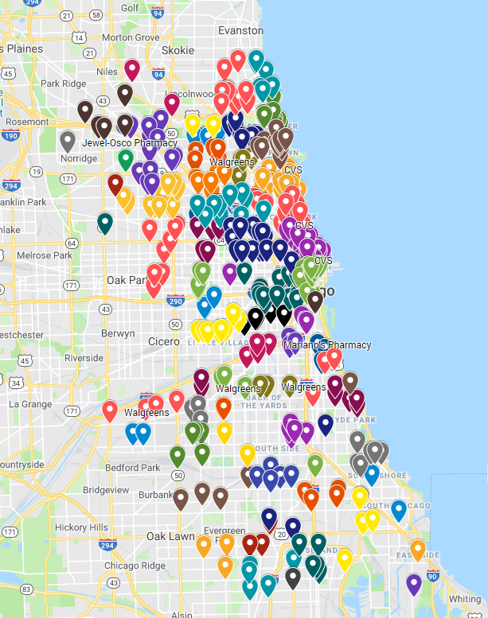
Summary
Visited 388 retail pharmacies
Visits averaged 5 minutes
Most receptive to visits
Concerns: unaware of standing
order; co-pays; claim processing;
stigma around naloxone

Slide 29

Notes:
In my presentation I will:
Take us through a brief history lesson on the evolution of pharmacy practice
Highlight some policies that contribute to its development
And finally, present the results of the our systematic review

Slide 30
PMP Updates
July 16, 2019

Slide 31
FY20
Funding
  GRF allocation
  Pending Applications
    Overdose Data to Action CDC-RFA-CE19-1904
    Harold Rogers BJA-2019-15111
  Website enhancement and expansion

Slide 32

Opioid Prescriptions

Slide 33

Opioid Patients

Slide 34
Patients Receiving > 90 MME

Slide 35
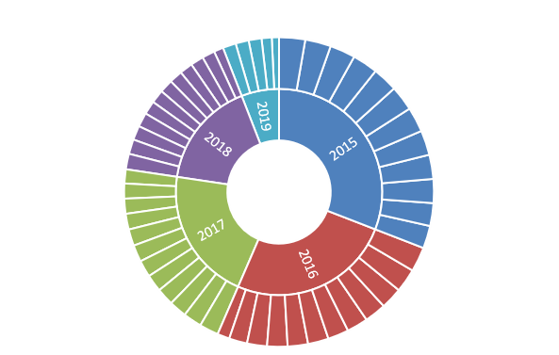
Patients Receiving Benzodiazepines and Opioids Concurrently
Total Patients receiving Benzos and Opioids Concurrently

Slide 36
Opioid Naïve on LA

Slide 37

5-5-6 Patients

Slide 38
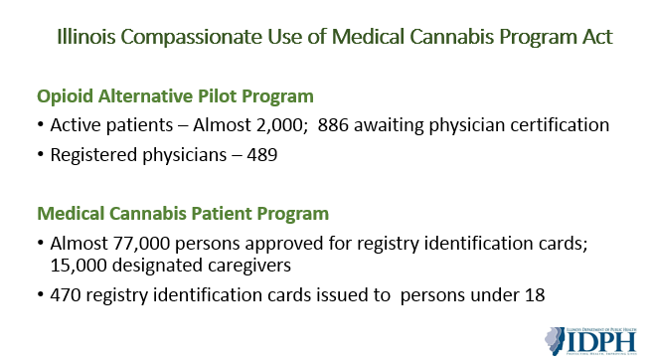

Slide 39
Project
Report Update
  Academic Detailing
  Continuing Education
  PMPnow
  Connection Funding
  FHIR Version

Slide 40
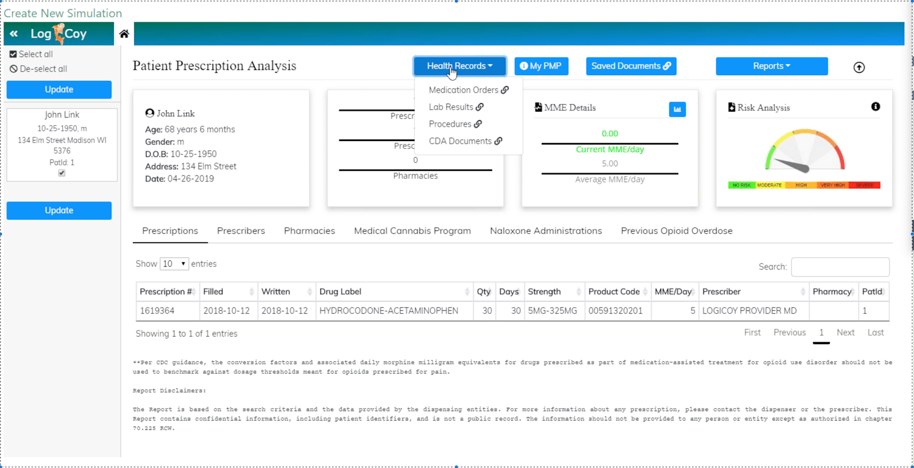

Slide 41

Legislative Update
  SB1665- Exempt Veterinarians from PMP
  HB163- real-time reporting and PMP fund
  HB2587- workers comp to query the PMP
  SB0411- changes doctor shopping threshold

Slide 42
Open Discussion

Slide 43

Next Meeting
  September 16th

Slide 44
Adjourn

