Slide 1
PMP Advisory Committee
March 20, 2019

Slide 2
Housekeeping
Mute phones
Do not place call on hold
Identify yourself

Slide 3
AGENDA
Roll Call
Meeting Minutes 12/19/18
Introduction of Members

Slide 4
PMPAC Members

Slide 5
David Liebovitz, MD Dliebovitz1@medicine.bsd.uchicago.edu
PMP Advisory Committee Chair

Slide 6
DHS required Annual Training
One Time Training
Open Meetings Act
Annually Trainings 2019
DHS Ethics
Sexual Harassment Prevention

Slide 7
PMPAC Member Terms https://stattrek.com/statistics/random-number-generator.aspx

Slide 8
PMP overview
Began in 1986, tracking Schedule II prescription drugs
2007 - addition of Schedule III – V
2008 - Website ILPMP.org live
2015 - Several Controlled Substance Act Changes

Slide 9
PMP overview
2015 - Controlled Substance Act Changes
Electronic Prescriptions for Schedule II, III, IV, and V
Medication Shopping
Changes to the PMP
Data submission- end of next business day
Designee Access
Advisory Committee

Slide 10
PMP overview
2018 - Controlled Substance Act Changes
Mandated Registration for all IL CS licensed prescribers
Mandated utilization
Mandate EHR integration by January 1, 2021

Slide 11
PMP overview
Primarily Grant Funded
Current Employees
Clinical Director – Sarah Pointer
Administrator – Craig Berberet
IT directors- Ed Dowllar & Stan Murzynski
Executive II- Andy Hollo
Project Directors – Jen Erickson & Barbie Sauer

Slide 12
Charges of the PMPAC
(1) provide a uniform approach to reviewing this ILCS Act in order to determine whether changes should be recommended to the General Assembly;

Slide 13
Charges of the PMPAC
(2) review current drug schedules in order to manage changes to the administrative rules pertaining to the utilization of the ILCS Act

Slide 14
Charges of the PMPAC
(3) review the following: current clinical guidelines developed by health care professional organizations on the prescribing of opioids or other controlled substances; accredited continuing education programs related to prescribing and dispensing; programs or information developed by health care professional organizations that may be used to assess patients or help ensure compliance with prescriptions; updates from the Food and Drug Administration, the Centers for Disease Control and Prevention, and other public and private organizations which are relevant to prescribing and dispensing; relevant medical studies; and other publications which involve the prescription of controlled substances

Slide 15
Charges of the PMPAC
(4) make recommendations for inclusion of these materials or other studies which may be effective resources for prescribers and dispensers on the Internet website of the inquiry system established under Section 318

Slide 16
Charges of the PMPAC
(5) semi-annually review the content of the Internet website of the inquiry system established pursuant to Section 318 to ensure this Internet website has the most current available information;

Slide 17
Charges of the PMPAC
(6) semi-annually review opportunities for federal grants and other forms of funding to support projects which will increase the number of pilot programs which integrate the inquiry system with

Slide 18
Charges of the PMPAC
(7) semi-annually review communication to be sent to all registered users of the inquiry system established pursuant to Section 318, including recommendations for relevant accredited continuing education and information regarding prescribing and dispensing.

Slide 19
Advisory Committee Link
To be added to website
Member list with contact information
Administrative Rules
Committee Bylaws
Guidelines involving the utilization of controlled substances
Presentations of interest
Links to articles and studies of interest

Slide 20
Peer Review
February 2019 meeting postponed
Next Meeting May 9th, 2019
New Members
Informational Packet
Data Distribution

Slide 21
Peer Review
3 physicians
Scott Glaser, MD
David Liebovitz, MD
3 pharmacists
Garry Moreland, RPh
Chris Herndon, Pharm D
Cara Brock, Pharm D
one dentist
Edward Rentscler, DDS
one advanced practice registered nurse
one veterinarian
Olivia Rudolphi , DVM
one physician assistant
Mindy Sanders, PA
one optometrist
Christina Moreettin, OD

Slide 22
Technical Update
New Website
Beta-testing
MyPMP

Slide 23
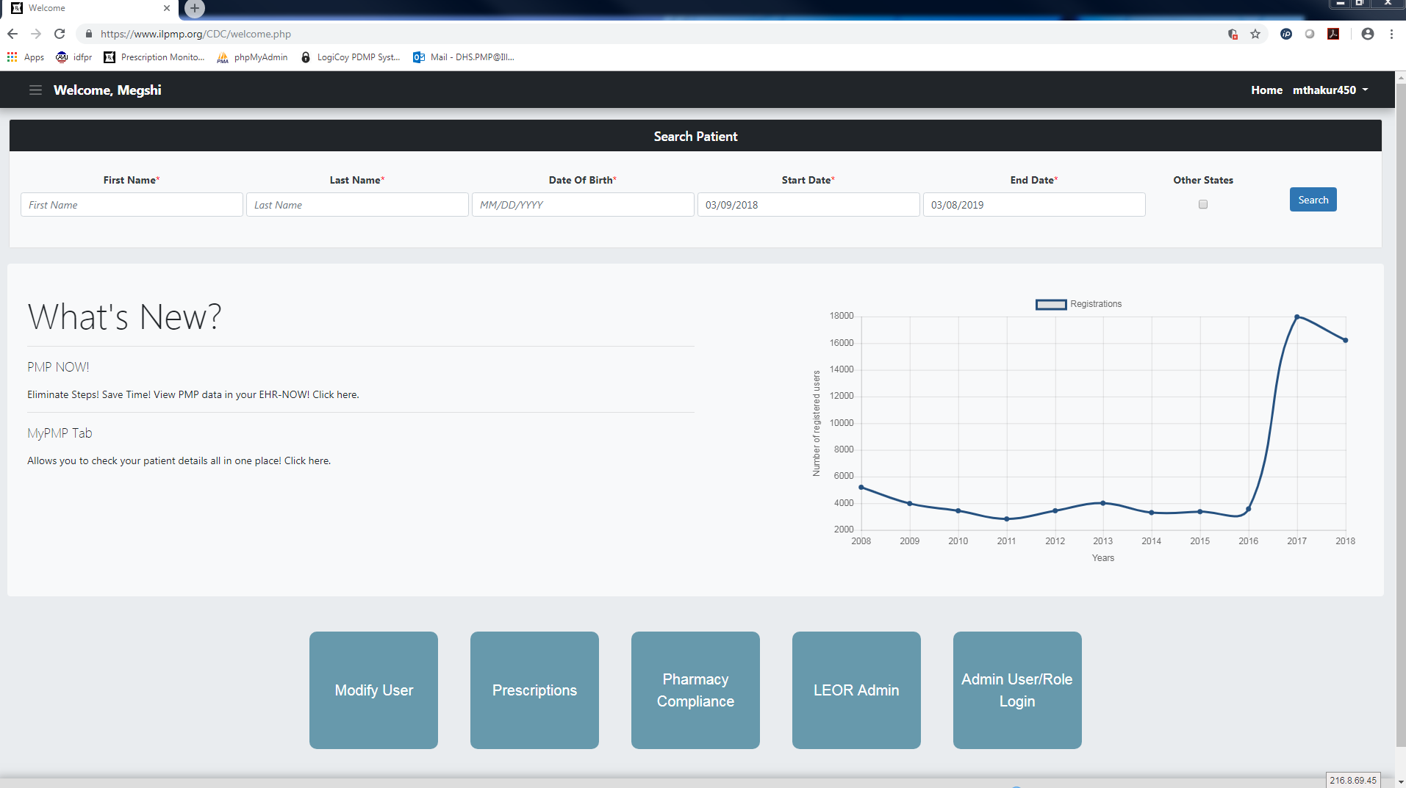

Slide 24
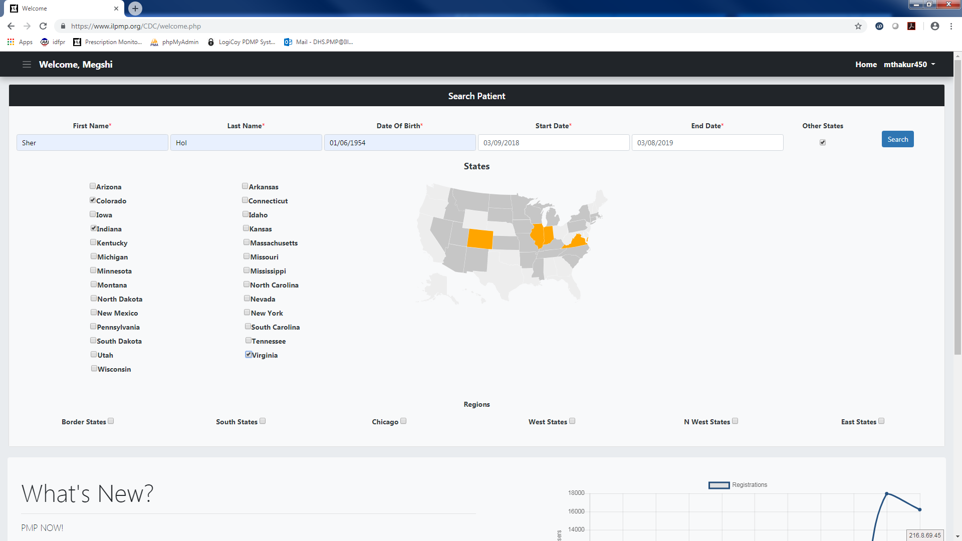

Slide 25
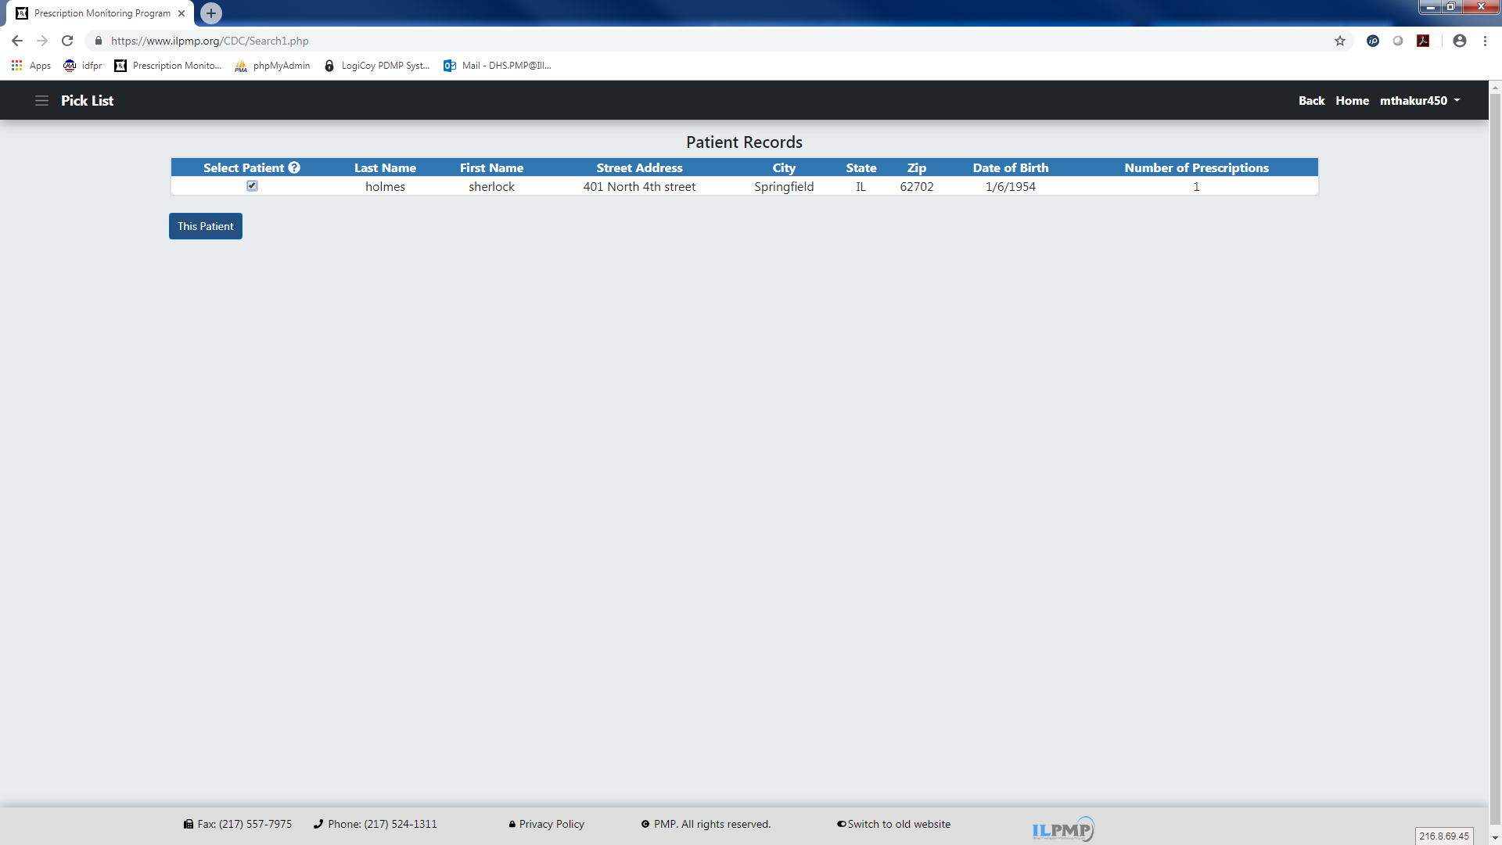

Slide 26
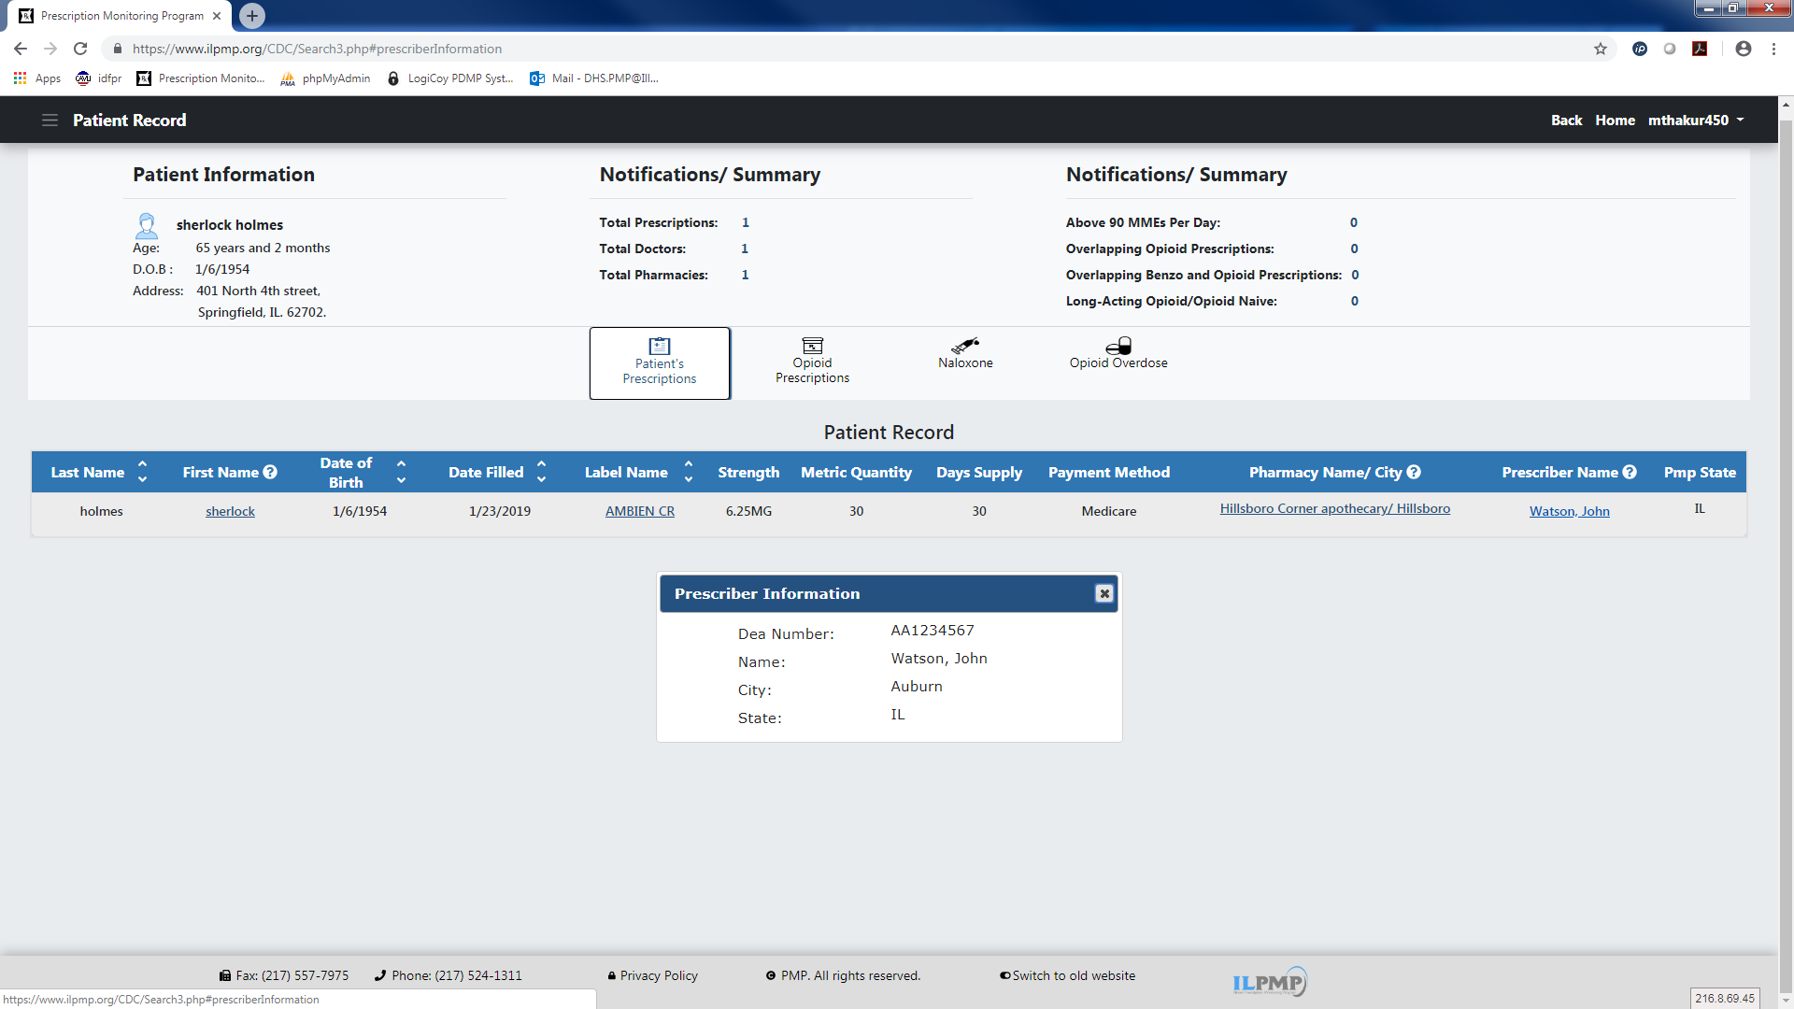

Slide 27
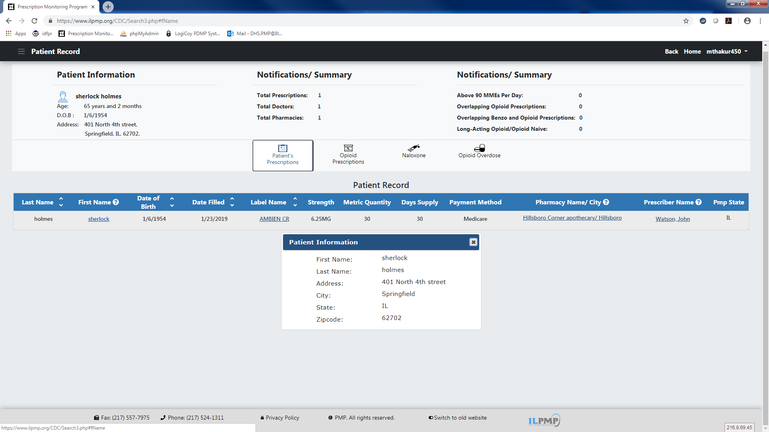

Slide 28
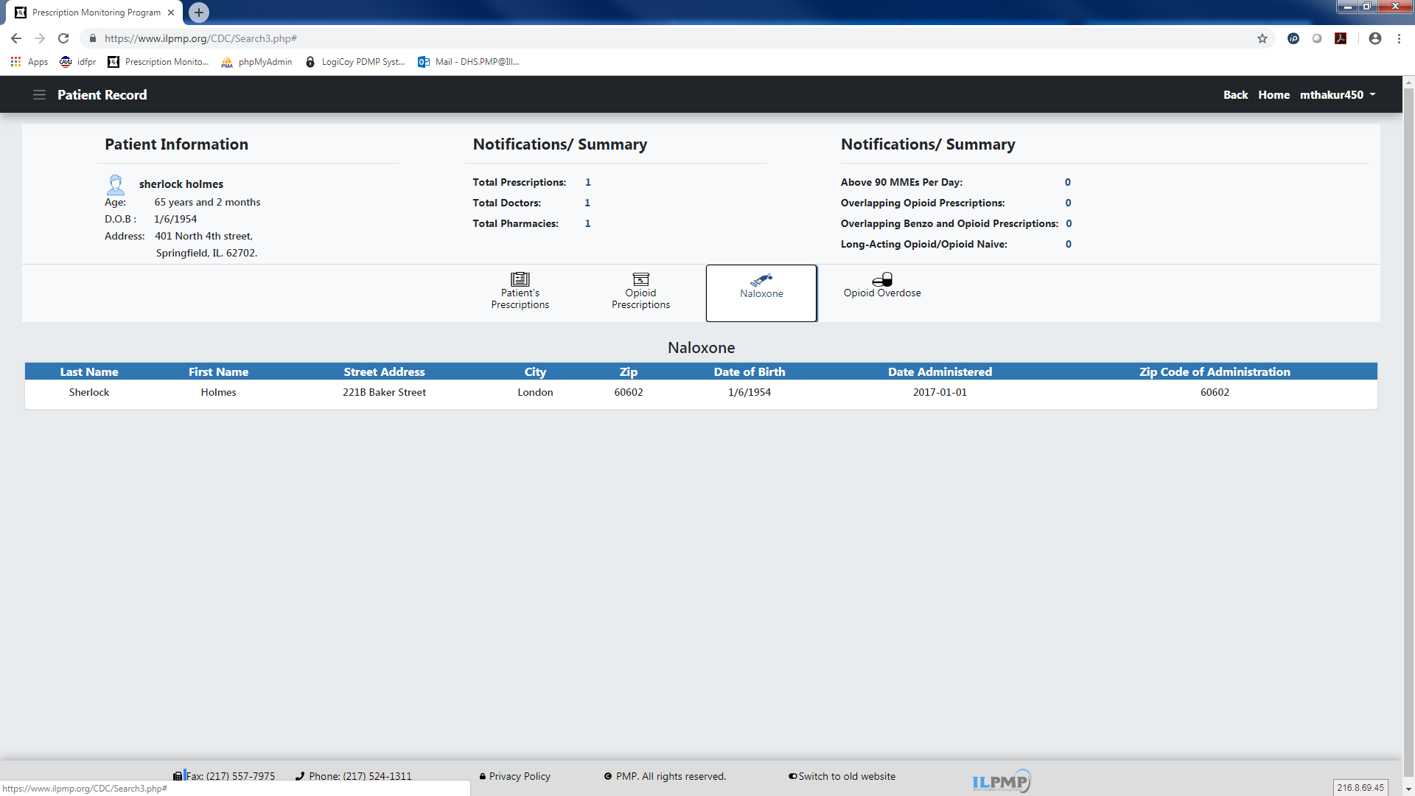

Slide 30
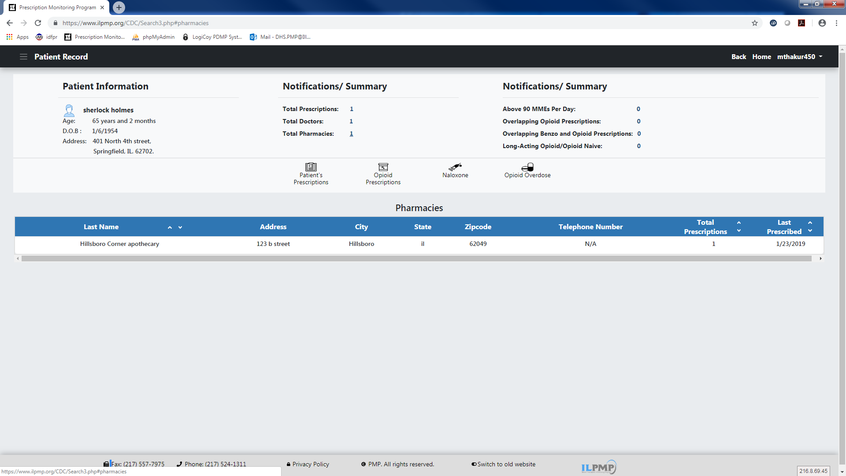

Slide 31
MyPMP
MyPMP is an analytical tool which can be used to quickly identify patients receiving co-prescribed medications or meeting the indicators as set by the Centers for Disease Control.
*Please note: we have developed no conclusions or judgements based on this information. It is not the PMP’s intent to impede but only to aid in patient care, as we are aware that some patients require large amounts of controlled substances for medical care.

Slide 32
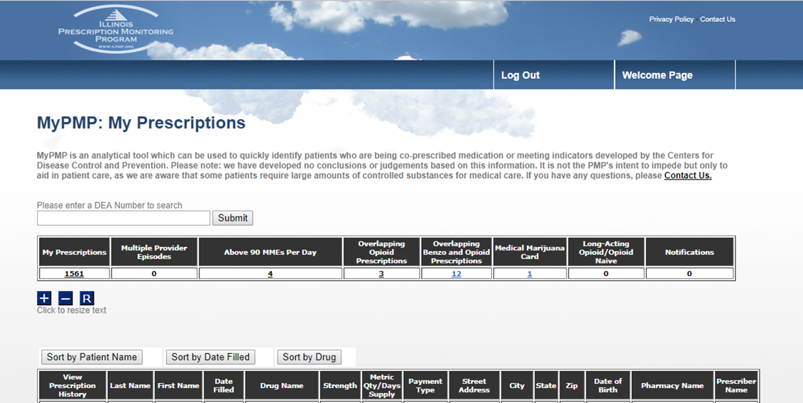

Slide 34
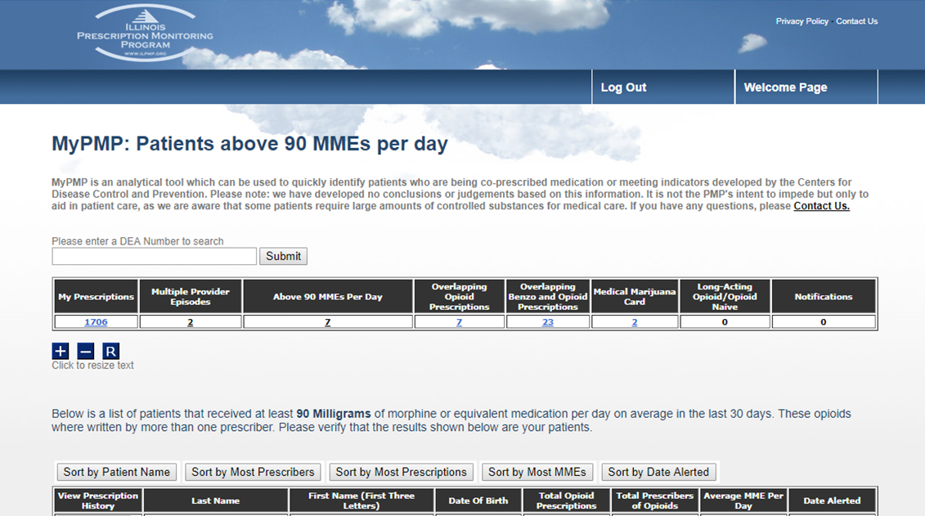

Slide 35
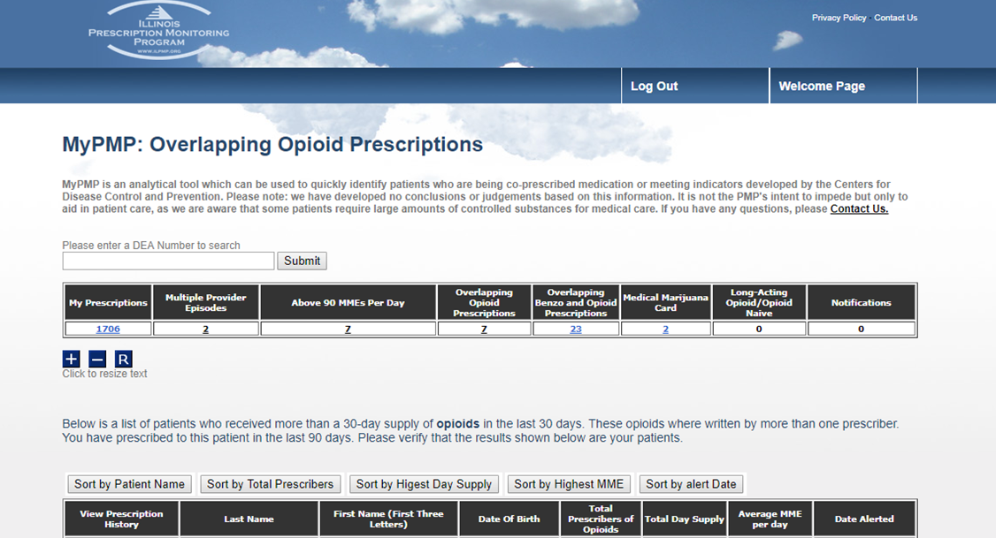

Slide 36
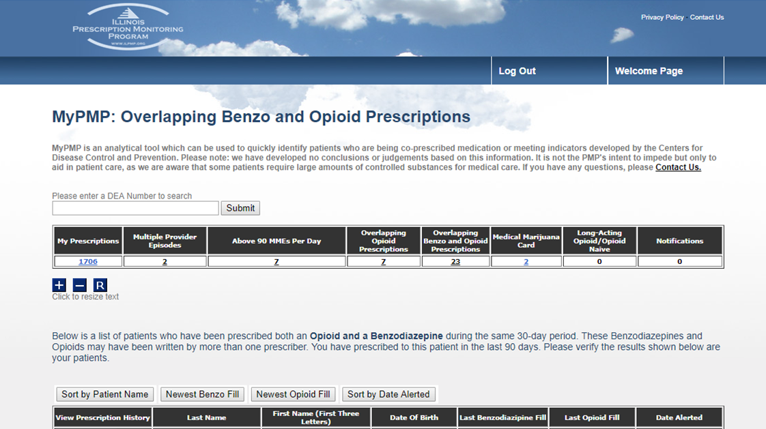

Slide 37
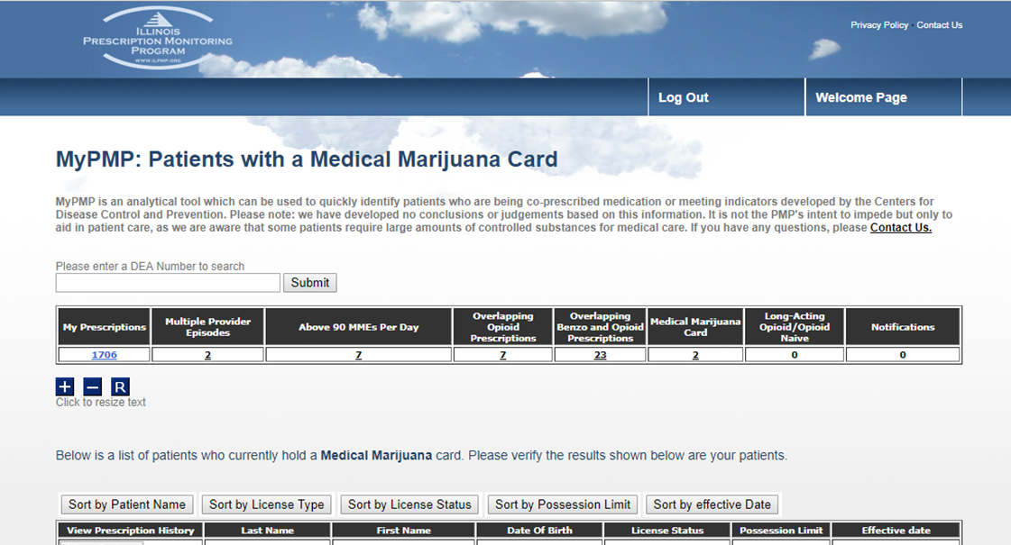

Slide 38
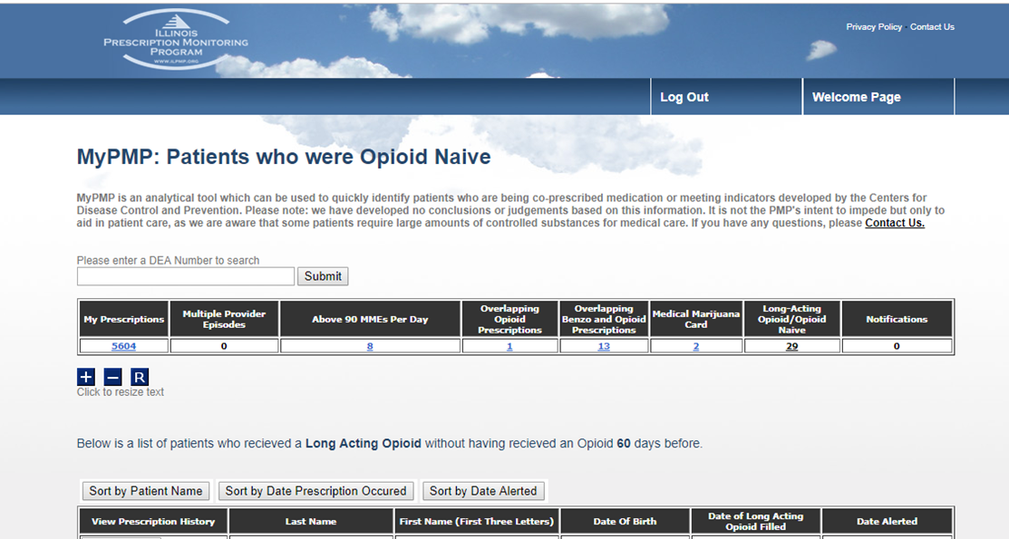

Slide 39
Legislative Update
HB163
SB0411
SB1665

Slide 40
HB 163
Amends the Illinois Controlled Substances Act. Provides that the information required to be transmitted under the prescription monitoring program must be transmitted not later than the end of the business day on which a controlled substance is dispensed, or at such other time as may be required by the Department of Human Services by administrative rule (rather than, at the end of the next business day on which the controlled substance is dispensed).

Slide 41
HB 0411
Amends the Illinois Controlled Substances Act. Requires prescribers to document the attempt to access the PMP prior to not only initial but also refill prescriptions for a C-II narcotics. It requires (rather than providing an option for) the PMP to issue unsolicited reports to prescribers and dispensers to inform them of potential medications shopping. It also changes the medication shopping threshold indicator from 3 prescribers and 3 pharmacies in a 1 month period to 2 prescribers, and 2 pharmacies in a 1 month period.

Slide 42
SB 1665
Excludes licensed veterinarians from the reporting and utilization requirements of the Prescription Monitoring Program.

Slide 43
Open Discussion

Slide 44
Adjourn

