Slide 1
PMP Advisory Committee
Chair: Sarah Pointer, Pharm D.
PMP Admin: Craig Berberet
September 19th, 2018

Slide 2
AGENDA
Roll Call
Meeting Minutes from June

Slide 3
Agenda
Old Business
Peer Review Meeting
Prescriber MPE Alerts
Composite Prescriber Reference Score
Prescriber Notification Letter
Analysis of Prescribers
New Business
Legislative Update
HB 4650
SB 2952 / HB4907
SB772/Public Act 100-0564
Administrative Rules Update
Technical Update
PMPnow
Naloxone Administration Data
Hospital Opioid Overdose Data
Medical Marijuana Data
Project Update
Academic Detailing
Continuing Education
Community Outreach
Miscellaneous Issues
PMPAC Vacancies
Open Discussion
Reminder of Next Meeting
December 19th, 2018
Call for motion to adjourn

Slide 4
Peer review meeting
September 18th, 2018

Slide 5
Composite Prescribing Reference Score
Based on an equation evaluating prescribers average MME/day as well as co-prescribing of opioids and benzodiazepines with and without a hypnotic
Prescriber notifications sent to 1,239 prescribers
Data refined based on feedback
Approximately 500 new prescriber notifications
24 prescribers identified for further analysis
Prescribing Metric Trends
MME/ day
Number of CS prescriptions
Day supply
Co-prescribing
Requests for information to be sent if deemed necessary

Slide 6
Legislative Update

Slide 7
HB 4650
Summary:
Amends the Illinois Controlled Substance Act to allow pharmacists to authorize a designee to consult the Prescription Monitoring Program on their behalf, defines "pharmacist" to include, but be not limited to, a pharmacist associated with a health maintenance organization or a Medicaid managed care entity providing services under the Illinois Public Aid Code.
Background:
The Association of Medicaid Health Plans proposed the original bill which was amended to become the current form. The current bill allows MCOs to access the PMP but with limits and only for clinical review purposes.

Slide 8
SB2952
Allows for licensed and non-licensed designees
Changes PMP Advisory Committee Meetings from quarterly to semi-annually
Changes the make-up of PMP Advisory Committee and Peer Review Committee

Slide 9
ILPMP Advisory Committee Members
Current Advisory Committee
12 Member Advisory Committee
Post SB2952
16 Member Advisory Committee
4 - Physicians
1 - Advanced Practice Nurse
1 - Physician Assistant
1 – optometrist/ophthalmologist
1 - Dentist
1 - Podiatric Physician
3 - Pharmacists
6 – Physicians (1 family practice, 1 pain, 4 physicians)
2 – Advanced Practice Nurses
1 - Physician Assistant
1 Optometrist
1 – Dentist
1 – Veterinarian
3 – Pharmacists
1 – clinical representative from a statewide organization representing hospitals

Slide 10
Peer Review Committee
Current Peer Review Subcommittee
Post SB2952
Peer Review Committee
3 - Physicians
2 - Pharmacists
3 – Physicians
3 – Pharmacists
1 – Advanced Practice Nurse
1 - Physician Assistant
1 -Optometrist
1 – Dentist
1 – Veterinarian

Slide 11
SB 336
On August 28, 2018, Governor Bruce Rauner signed Senate Bill 336, the Alternatives to Opioids Act of 2018, amending the Compassionate Use of Medical Cannabis Pilot Program Act, which amends the Compassionate Use of Medical Cannabis Pilot Program Act, into law. There are several components to the provisions of Senate Bill 336.
It removes the fingerprinting requirement for new applicants to the program;
It allows the Illinois Department of Public health (IDPH) to issue provisional access to a licensed medical cannabis dispensary until full processing of applications can be completed; and
It includes provisions for an Opioid Alternative Pilot Program which would provide access to medical cannabis for people with physician documentation of an opioid prescription.
Medical Cannabis Registry Program Newsletter

Slide 12
Public Act 100-0564
Administrative Rules In Process
Title 77, Public Health Chapter X: Department of Human Services Subchapter e: Controlled Substances Activities Part 2080, Section 2080.20, Section 2080.190, and Section 2080.210
PMP Administrative Rules Subcommittee

Slide 13
Technical Update

Slide 14
PMPnow Outreach
Recent Activity
Two Hospital Outreach Projects
E.H.R. Vendors
Central and Southern Region
Current Strategy
Email Outreach
Association Collaboration
PMPnow Landing Page

Slide 15
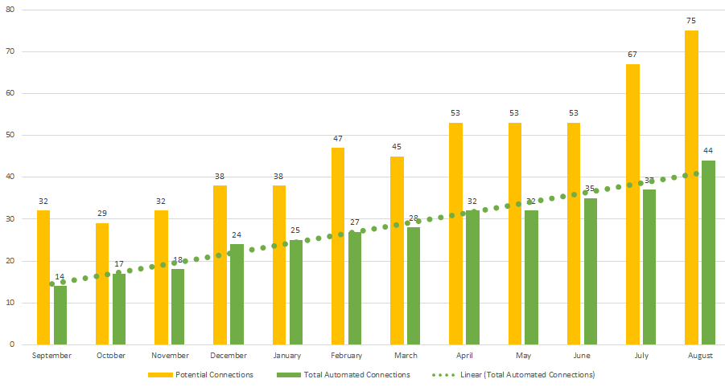
PMPnow Connections
PMP Automated Connections: September 2017 – August 2018

Slide 16
Utilization: PMPnow Queries
In August 2018, queries were up over 500% compared to August of 2017.
August 2018: 4,995,576
August 2017: 991,207
*The number of requests via automated connections. These requests can be made be made by an EHR system before a prescriber has seen the patient.

Slide 17
New Users / Total Users
New Users by Month, 2018
Total Users by Month, 2018
Increase from Jan. to Aug.: 4,961 (8%)
Source: https://www.ilpmp.org/MonthlyStatsMain.php

Slide 18
Website Requests / PMPnow Requests
Website and PMPnow Requests by Month, 2018
Jan.-Aug. Changes
PMPnow: +1.4M (38%)
Website: +136K (44%)
Total: +1.5M (38%)
Source: https://www.ilpmp.org/MonthlyStatsMain.php

Slide 19
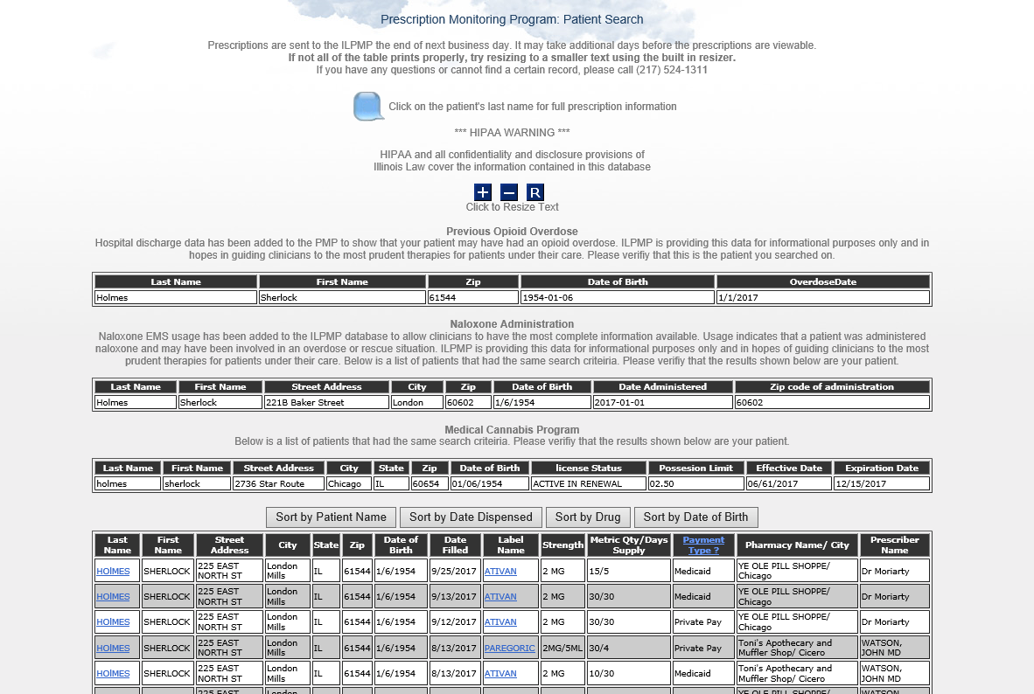
New Data Available on PMP website

Slide 20
Project Updates

Slide 21
Academic Detailing
UIC Project
Continuing Education
Contract with SIU
Community Outreach
Delta
CDPH
Sangamon County DPH

Slide 22
What are the results of our efforts ?

Slide 23
MME Trends
MME (Morphine Milligram Equivalent) was a tool developed to equate the many different opioids into one standard value based on morphine and its potency.

Slide 24
MPE Trends
Graph indicates the number of patients meeting or exceeding thresholds that have been associated with “Doctor Shopping”.

Slide 25
Miscellaneous Issues
Open Discussion

Slide 26
Committee Vacancies
2- Physicians
1- Optometrist

Slide 27
Open Discussion?

Slide 28
Next Meeting December 19th 2018 Meeting adjourned

