Slide 1
PMP Advisory Committee
Chair: Sarah Pointer, Pharm D.
PMP Admin: Craig Berberet
June 20th, 2018

Slide 2
AGENDA
Roll Call
Meeting Minutes from March

Slide 3
Agenda
Old Business
Peer Review Meeting 03/21/2018
Prescriber Unsolicited Letters
Targeted Prescriber Letter
New Business
Legislative Update
SB2952/ HB4907
HB4650
SB772/Public Act 100-0564
Registration Update
IHA MEF Workgroup
Administrative Rules Update
Opioid Action Plan Implementation Report
Technical Update
PMPnow
Dashboard
Designee Pages
RxCheck Hub
Project Update
Academic Detailing
Continuing Education
Community Outreach
Medical Marijuanna
Naloxone Administration Reporting
Coroner/ME Access
Miscellaneous Issues
Reminder of Next Meeting
Call for motion to adjourn

Slide 4
Peer review meeting 03/21/18
Prescriber Unsolicited Letters
Targeted Prescriber Letter

Slide 5
Legislative Update

Slide 6
HB4907/ SB2952
Brief Summary:The Department, in consultation with the Advisory Committee, shall adopt rules allowing licensed prescribers or pharmacists who have registered to access the Prescription Monitoring Program to authorize a licensed or non-licensed designee employed in that licensed prescriber’s office or a licensed designee in a licensed pharmacist’s pharmacy, and who has received training in the federal Health Insurance Portability and Accountability Act to consult the Prescription Monitoring Program on their behalf. The rules shall include reasonable parameters concerning a practitioner’s authority to authorize a designee, and the eligibility of a person to be selected as a designee.

Slide 7
ILPMP Advisory Committee Members
Current Advisory Committee
12 Member Advisory Committee
Post SB2952
16 Member Advisory Committee
4 - Physicians
1 - Advanced Practice Nurse
1 - Physician Assistant
1 – optometrist/ophthalmologist
1 - Dentist
1 - Podiatric Physician
3 - Pharmacists
6 – Physicians (1 family practice, 1 pain, 4 physicians)
2 – Advanced Practice Nurses
1 - Physician Assistant
1 Optometrist
1 – Dentist
1 – Veterinarian
3 – Pharmacists
1 – clinical representative from a statewide organization representing hospitals

Slide 8
HB4650
Brief Summary:
This legislation allows a pharmacist to authorize a designee to access PMP data on their behalf, defines “pharmacist” to include, but not limited to, a pharmacist associated with a HMO or Medicaid managed care entity.
Agency Position and Reason:
Oppose. We stand opposed to the amendatory language allowing non-licensed or non-registered individuals to have access to the ILPMP, and personal patient data to individuals who are not subject to compliance as set forth by the IDFPR. This would expose ILPMP to persons not currently permitted to access the data and could be subject to HIPAA issues.
ISMS opposition included: the bill as written is way too broad and would significantly deviate from the stated mission of our PMP. There is muddled understanding of how payers would use PMP data, and the bill as written would give MCO-utilized pharmacists unfettered access to any patient’s PMP data, whereas prescribers (and their designees) are only supposed to access data of their specific patients.

Slide 9
SB772/ Public Act 100-0564
MEF PMP Workgroup
February 28th (then monthly)
Designees and Designee Process
Documenting Access
Administrative Rules update

Slide 10
PMP Registrations
64,393 PMP Users (as of February 8, 2018) update this and know total cs holders
27,451 registrations since December, 2017
53,403 Prescribers
10,990 Dispensers
Four to Five weeks behind on registrations

Slide 11
Registrations

Slide 12
PMP Searches by Year
Year | Searches
2013 | 1,431,538
2014 | 2,232,916
2015 | 2,713,137
2016 | 4,698,186
2017 | 13,377,213

Slide 13
Technical Update
PMPnow
Dashboard
Designee Pages
RxCheck Hub

Slide 14
PMPnow
27 Connections (Illinois, Missouri and Iowa)
Facility type
22 hospitals
2 clinics
2 pain clinics
1 FQHC
3,243,825 searches in January, 2018
636 Sites
Includes ambulatory sites and ambulances
Three request types
35 facilities in the pipeline

Slide 15
PMPnow Outreach and Features
Marketing
EHR/Medication Management Vendor
Hospital/FQHC/Clinic/Prompt Care/Dental Office/Pharmacy Outreach
PMPnow Features
Interstate data via PMPnow
Patient Identity Resolution
MPE/MME (calculator)/ CDC 5 indicators integration
WE WILL CONNECT TO ANY HEALTHCARE ORGANIZATION THAT WOULD LIKE TO RECEIVE PMP DATA!!!

Slide 16
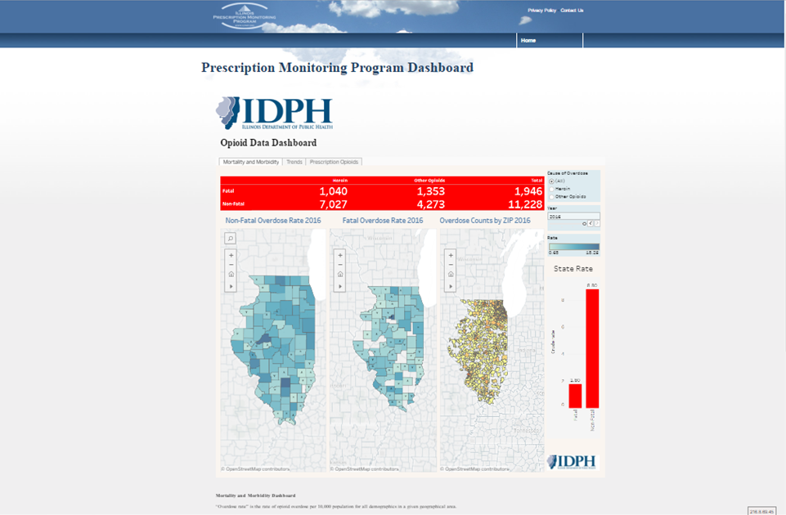

Slide 17
Project Updates

Slide 18
Academic Detailing
UIC Project
Continuing Education
Contract with SIU
Community Outreach
Newsletter
County reports

Slide 19
Medical Marijuana
Naloxone Administration Reporting
Coroner / Medical Examiner Access

Slide 20
Miscellaneous Issues
Open Discussion

Slide 21
Next Meeting September 19th 2018 Meeting adjourned

